Slide 1
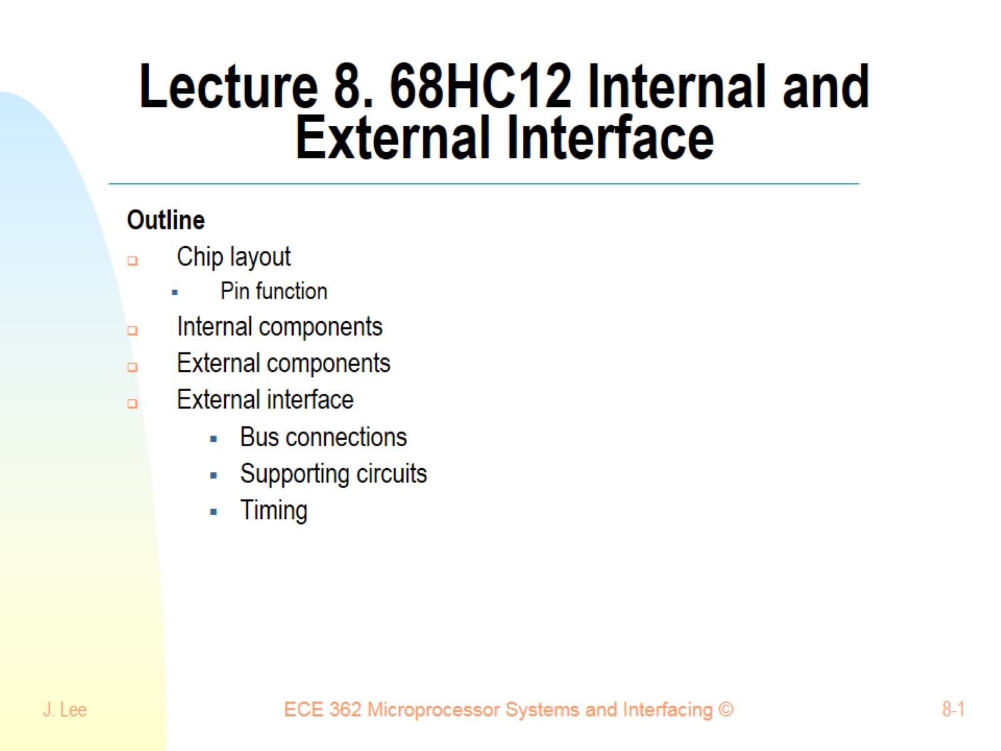
Lecture 8. 68HC12 Internal and External Interface

Slide 2
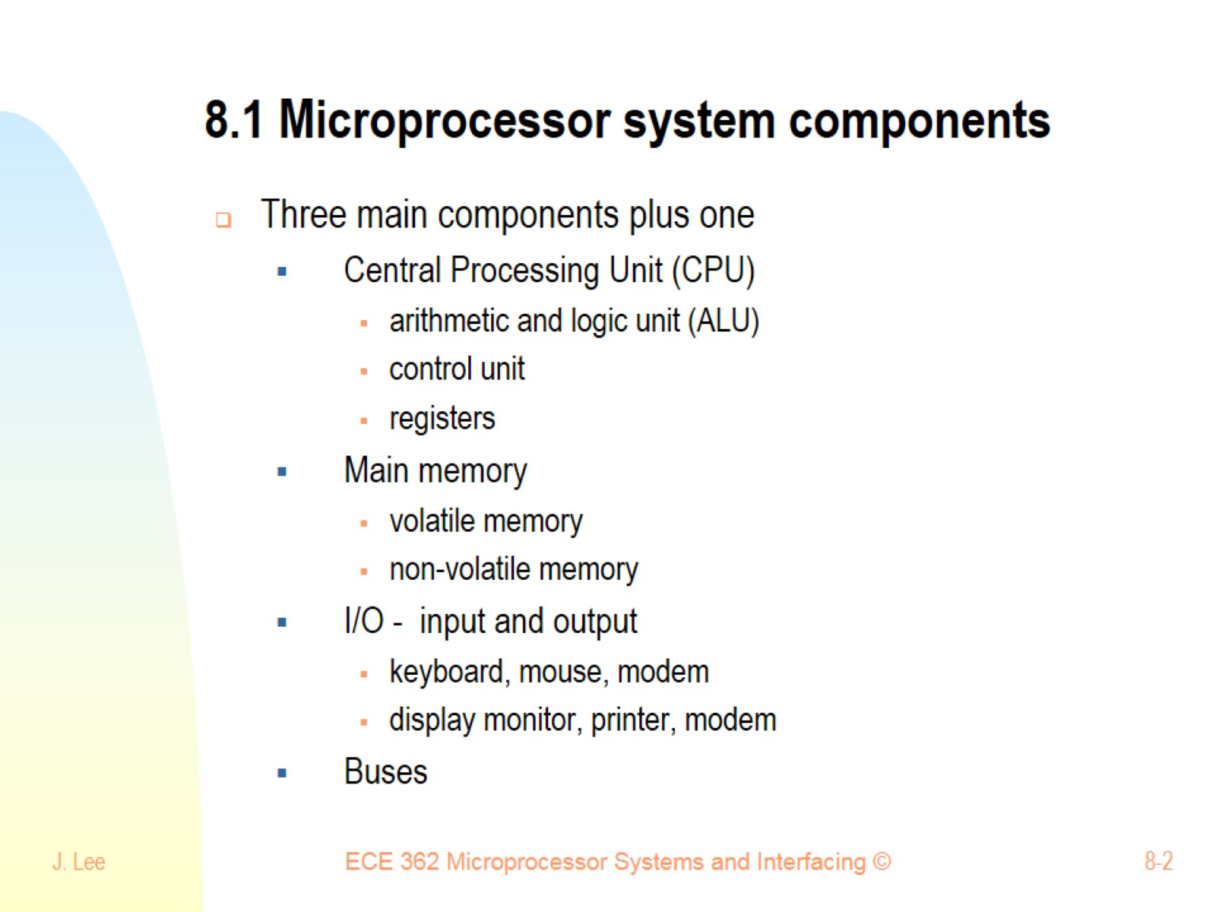
8.1 Microprocessor system components

Slide 3
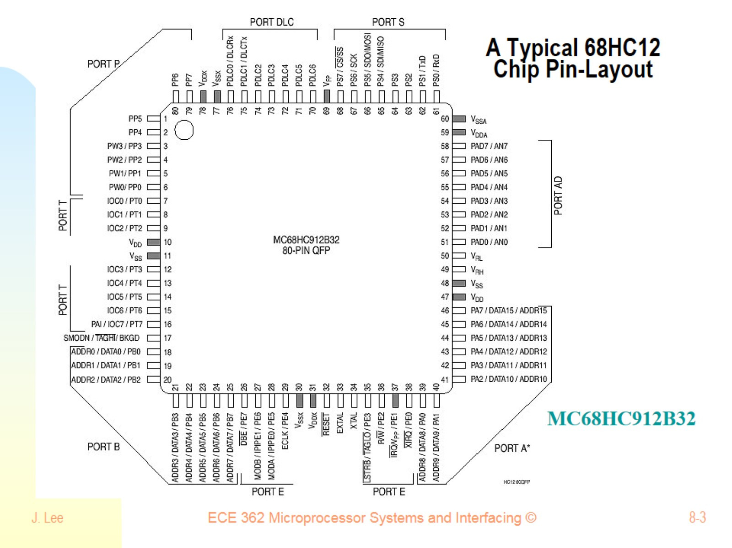
A Typical 68HC12 Chip Pin-Layout

Slide 4
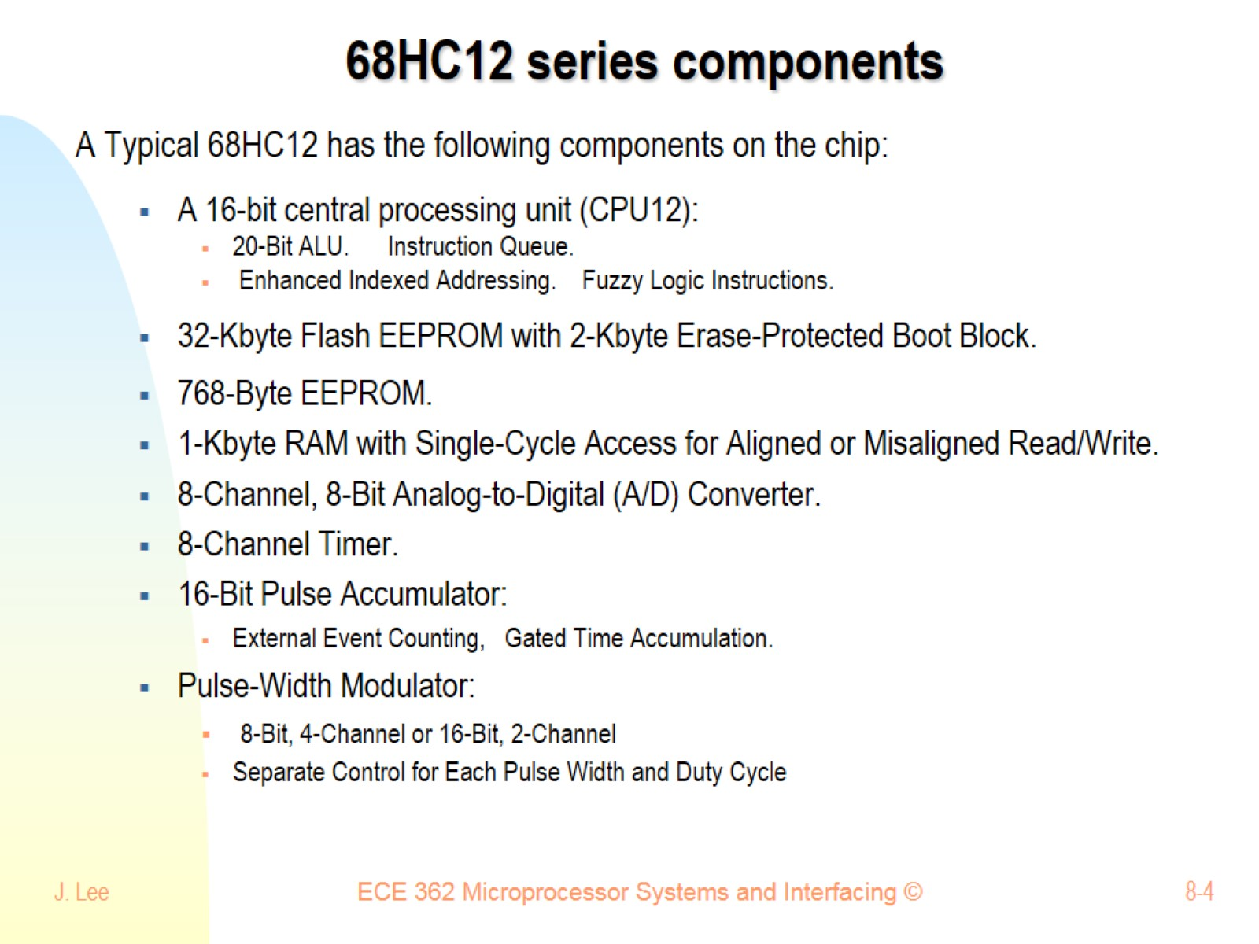
68HC12 series components

Slide 5
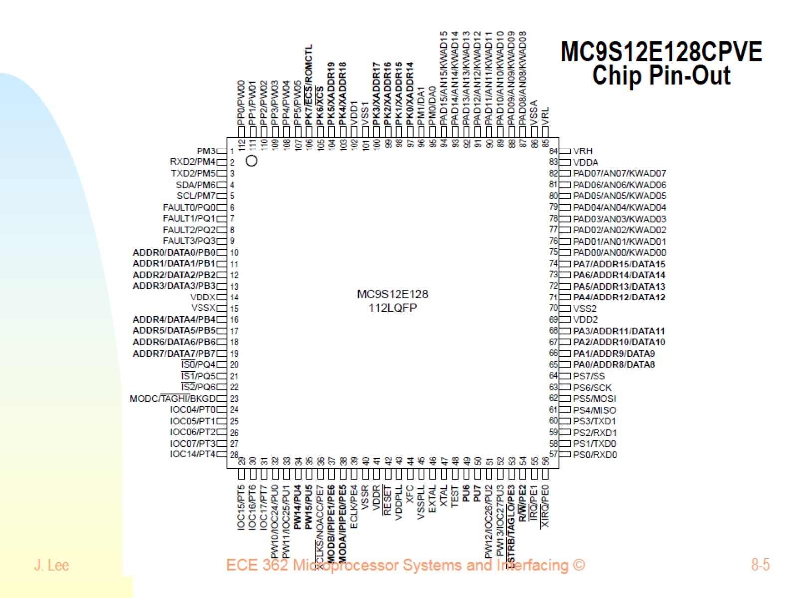
MC9S12E128CPVE Chip Pin-Out

Slide 6
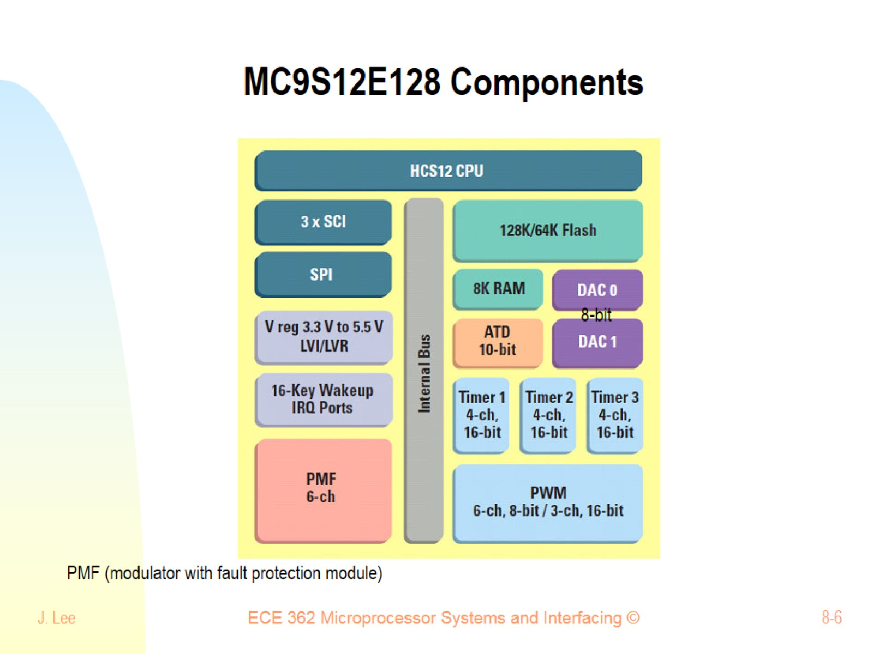
MC9S12E128 Components

Slide 7
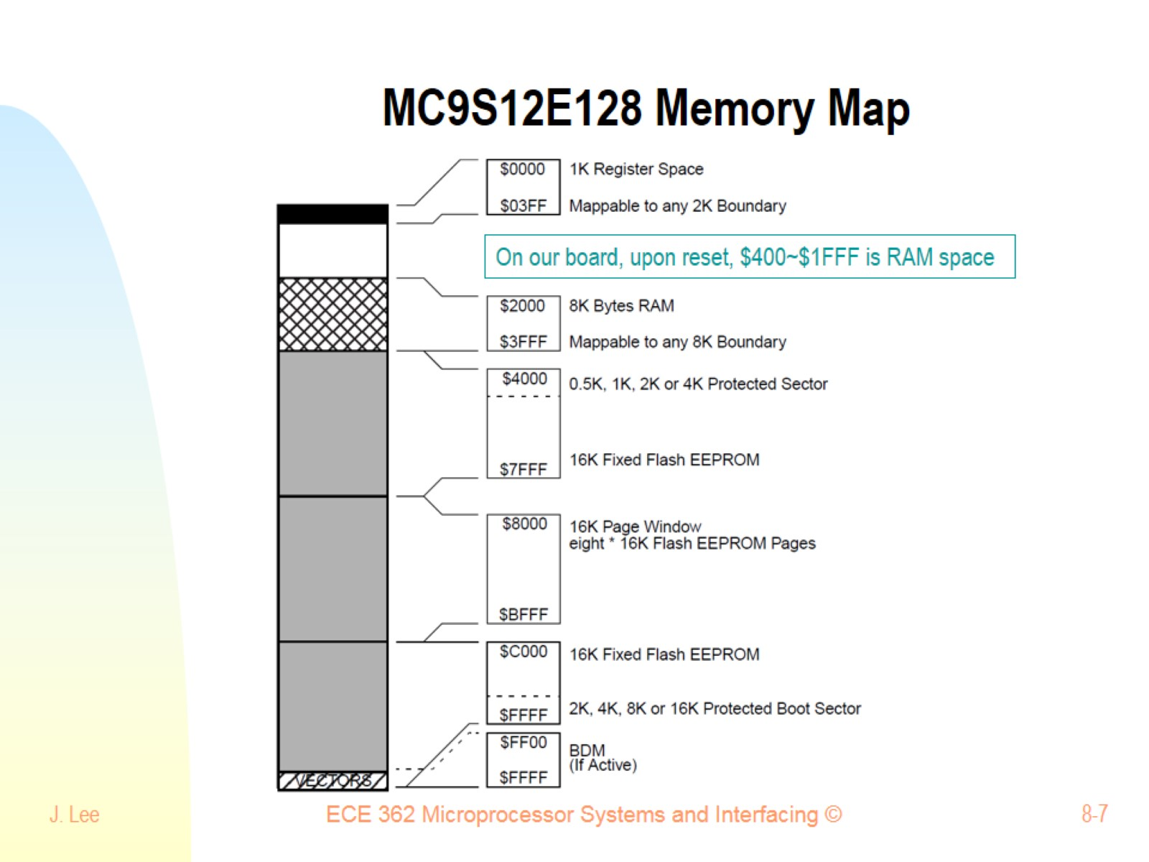
MC9S12E128 Memory Map

Slide 8
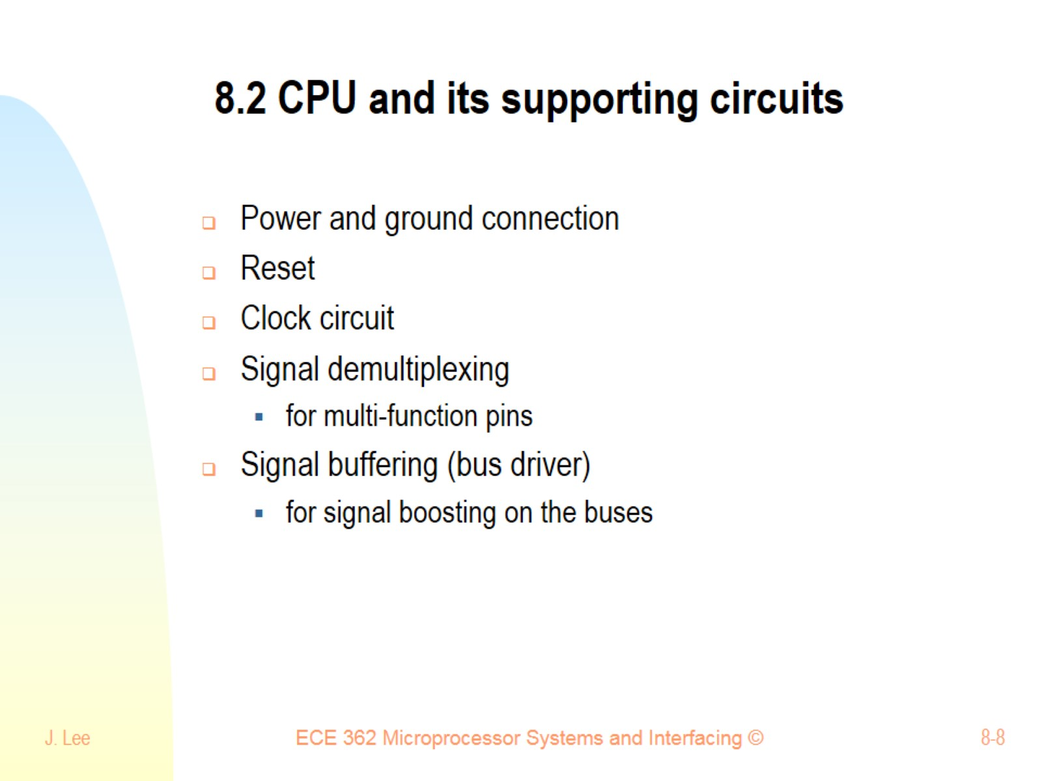
8.2 CPU and its supporting circuits

Slide 9
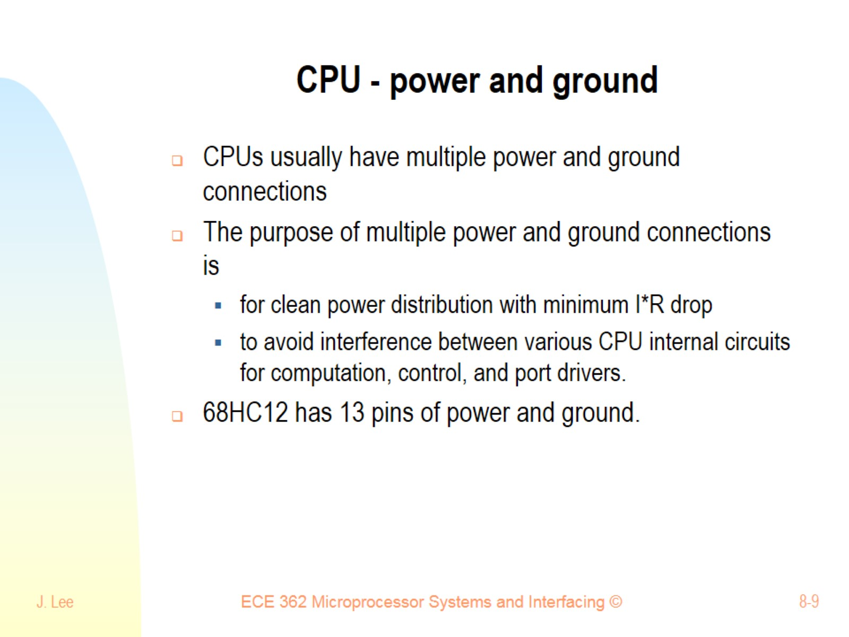
CPU - power and ground

Slide 10
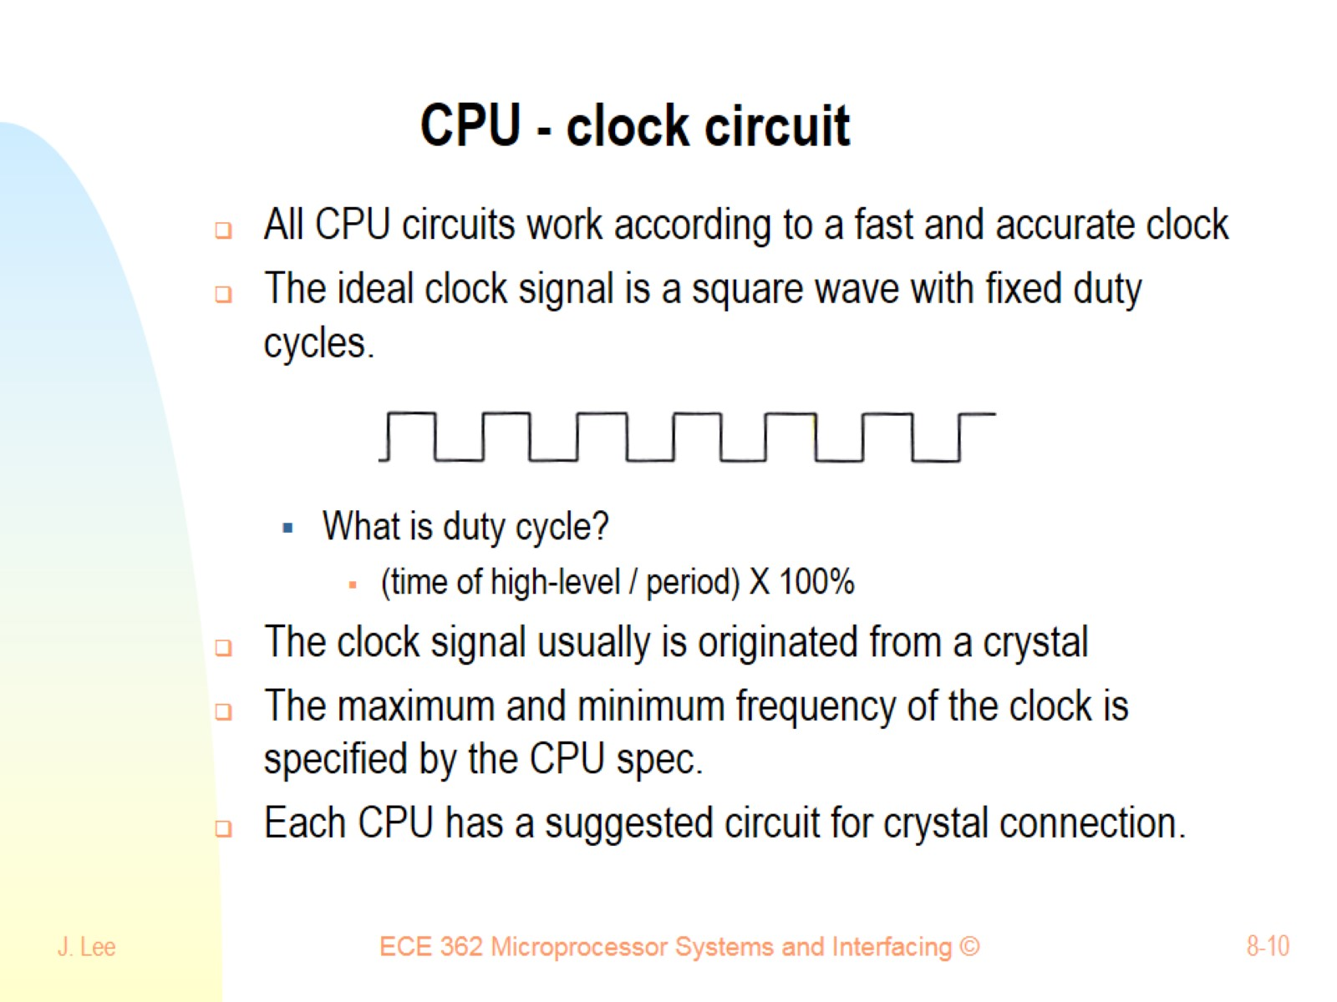
CPU - clock circuit

Slide 11
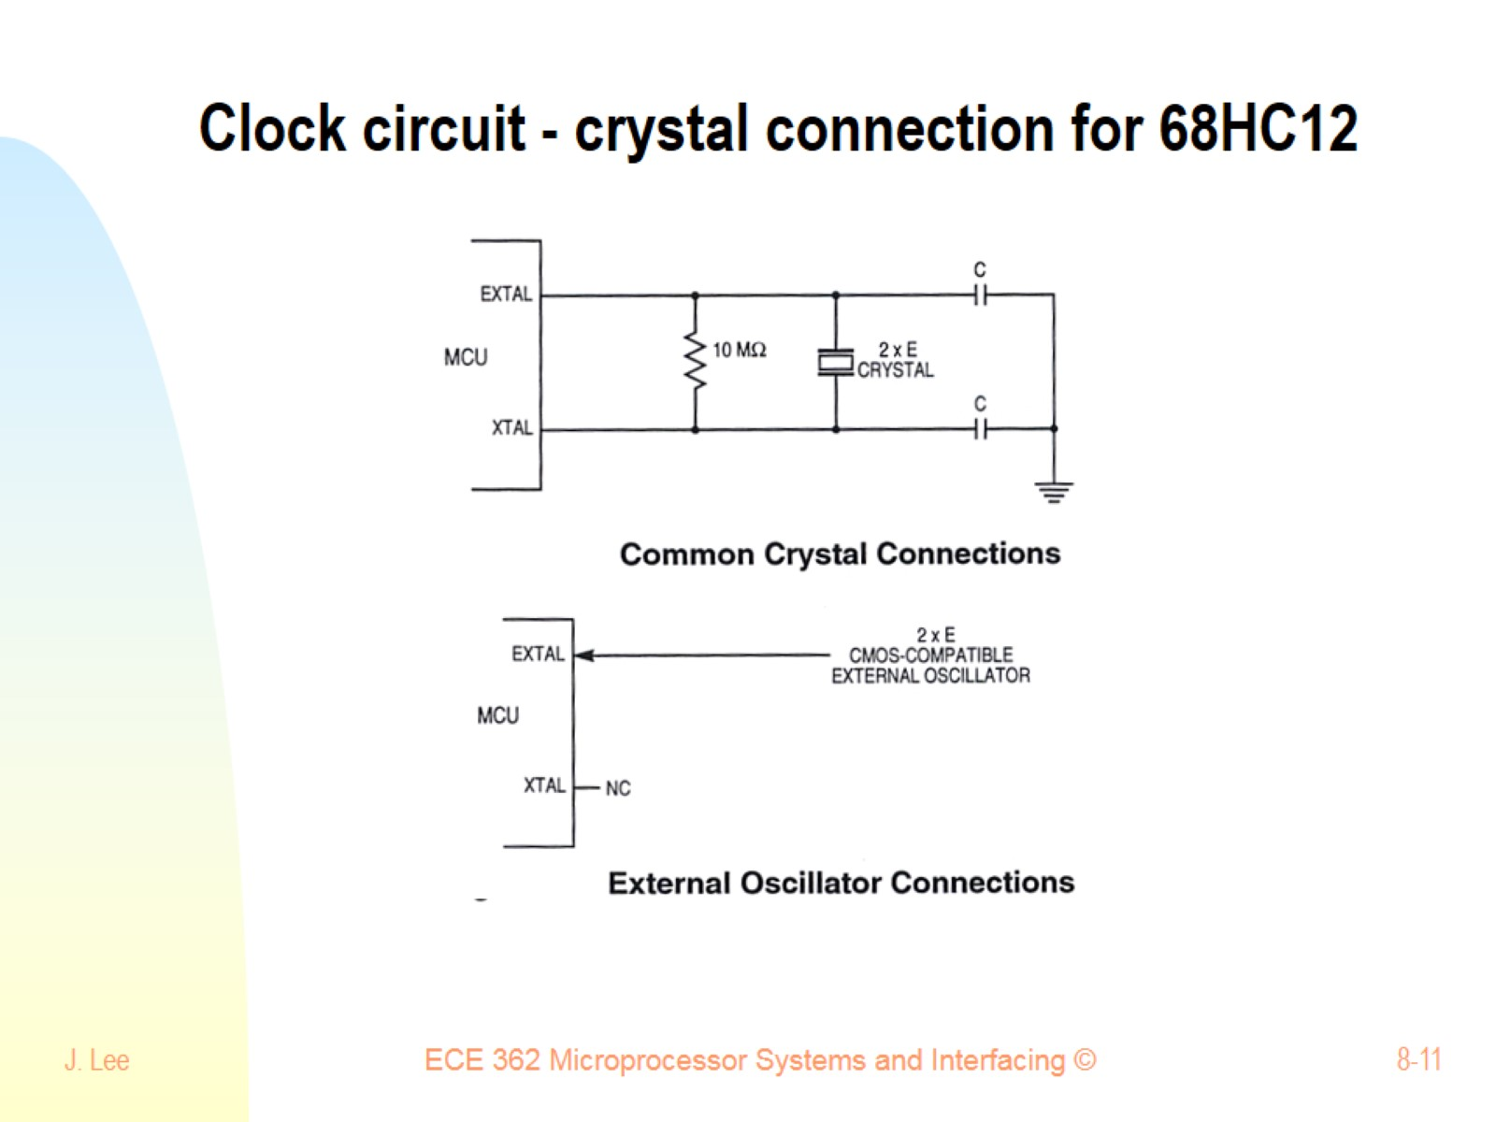
Clock circuit - crystal connection for 68HC12

Slide 12
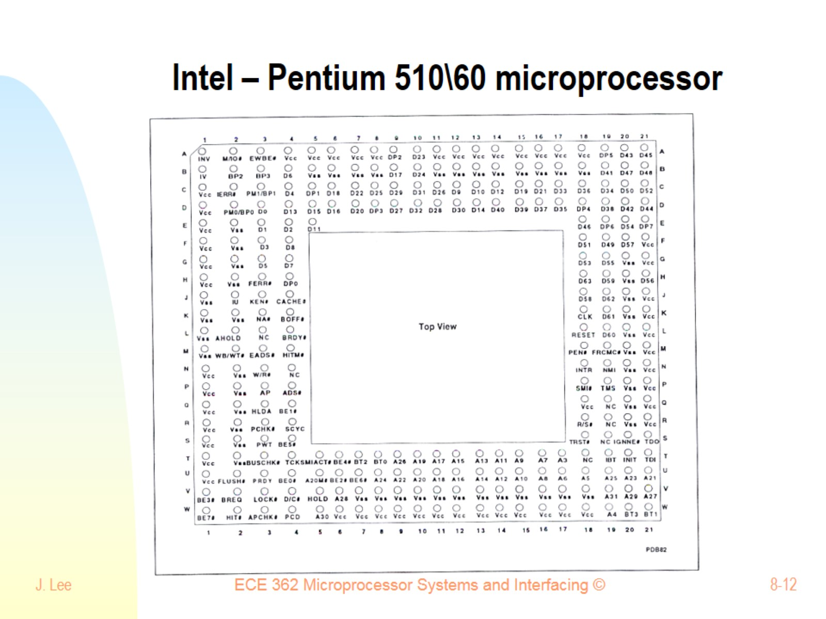
Intel – Pentium 510\60 microprocessor

Slide 13
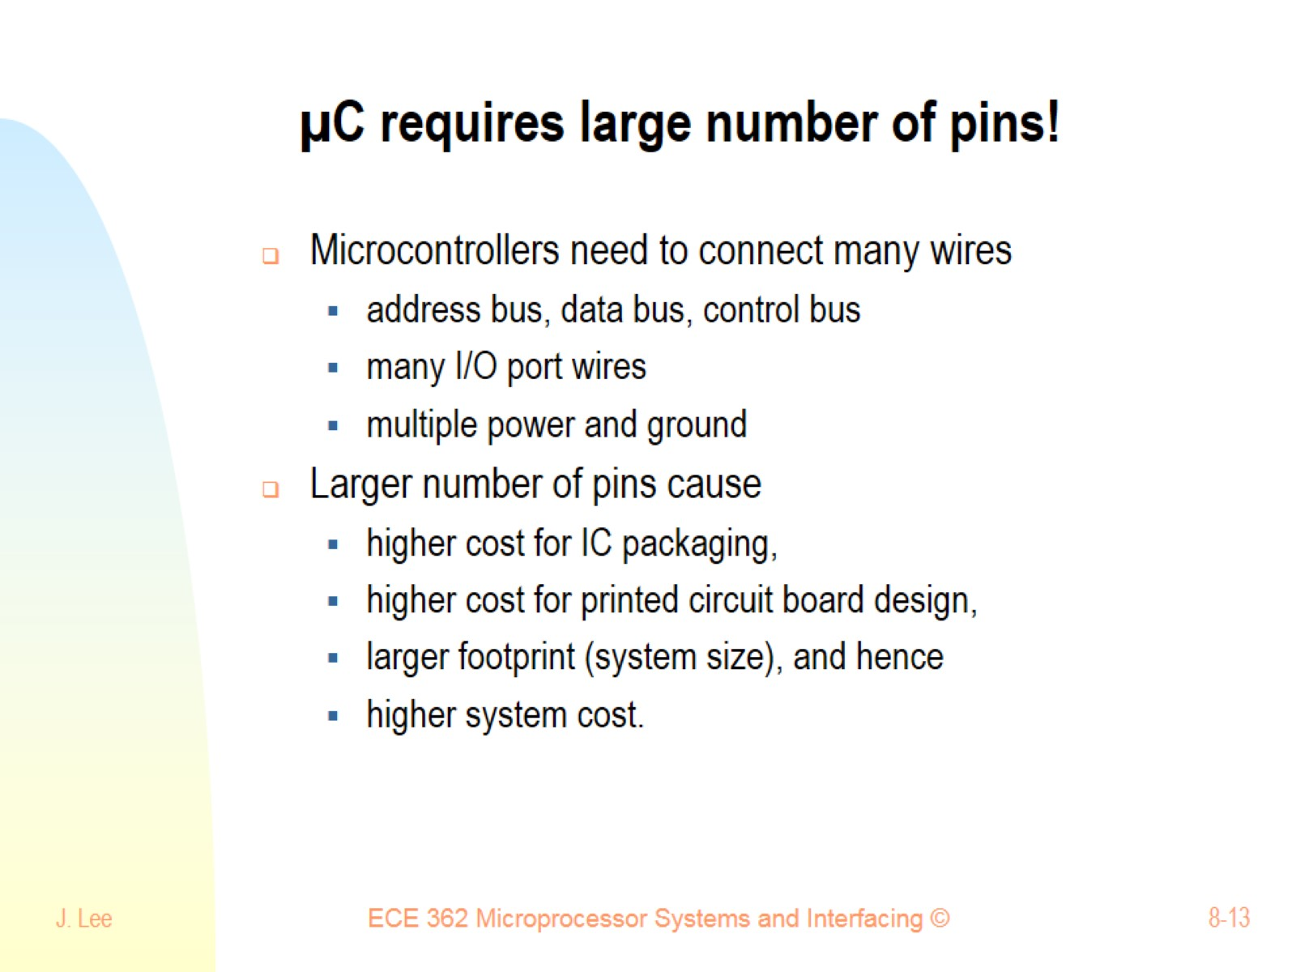
µC requires large number of pins!

Slide 14
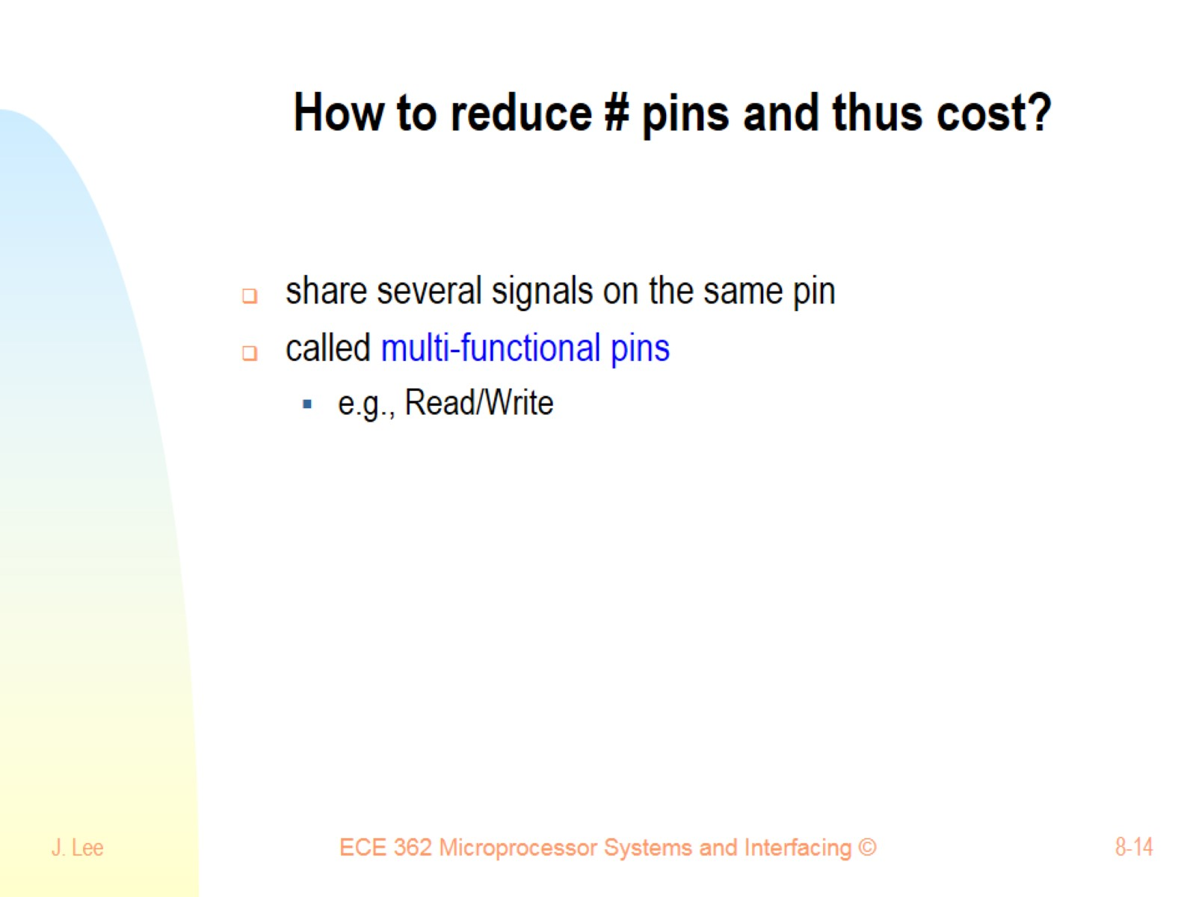
How to reduce # pins and thus cost?

Slide 15
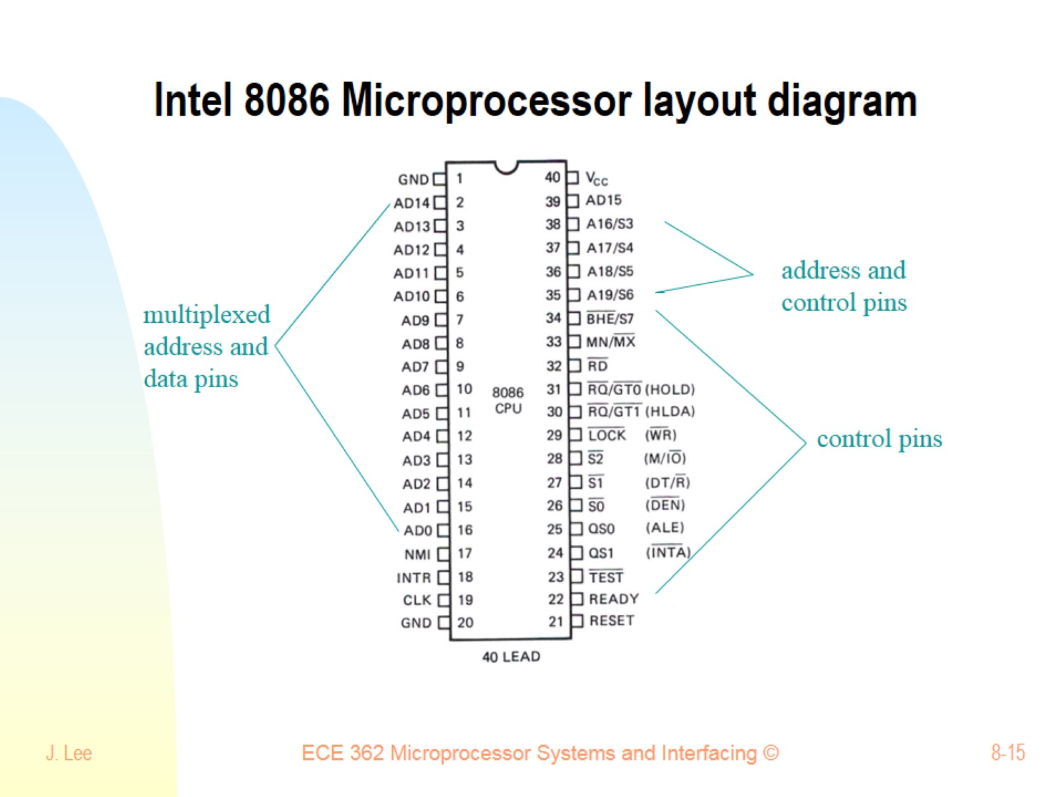
Intel 8086 Microprocessor layout diagram

Slide 16
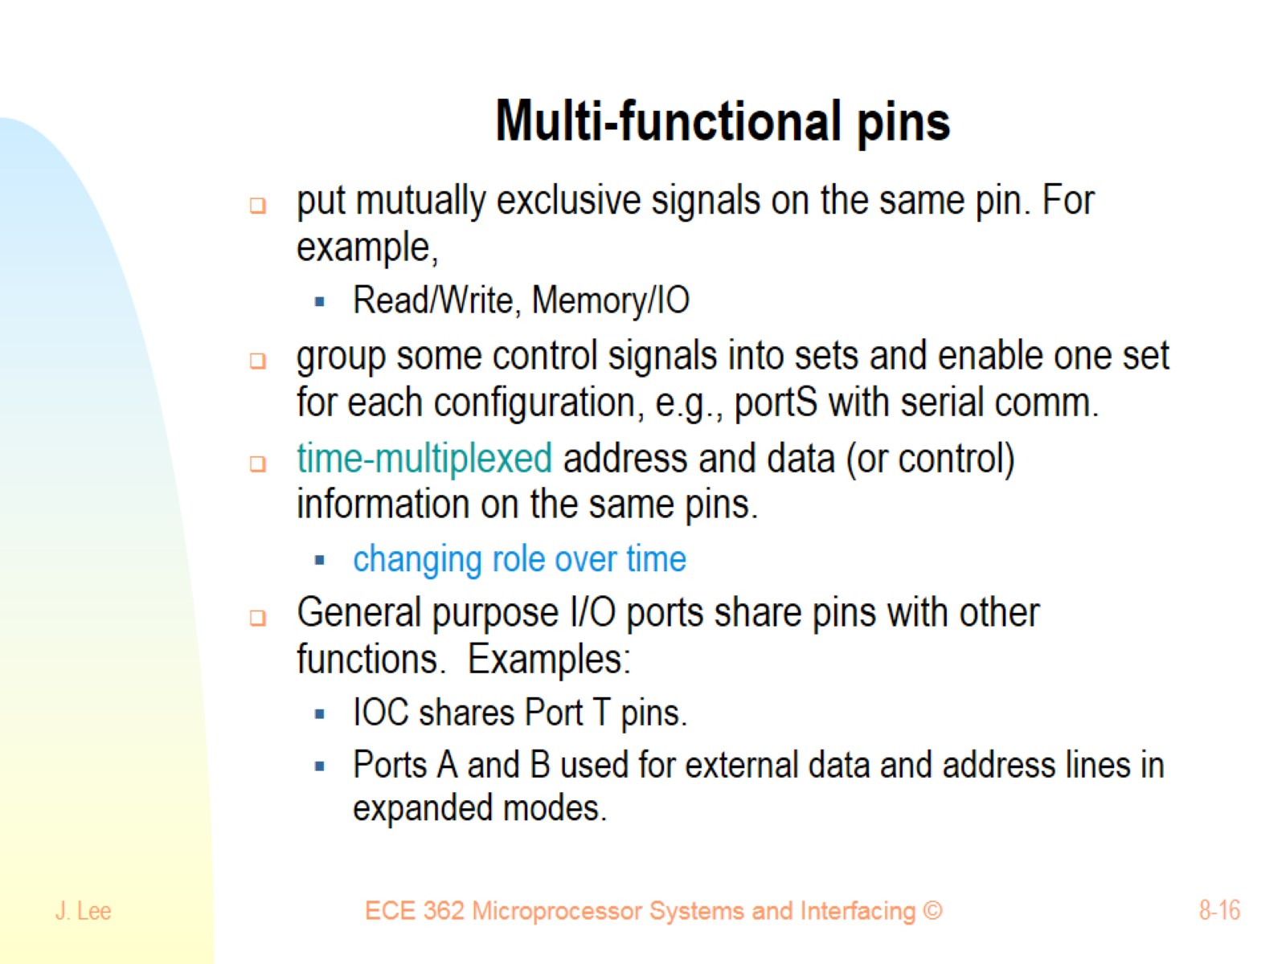
Multi-functional pins

Slide 17
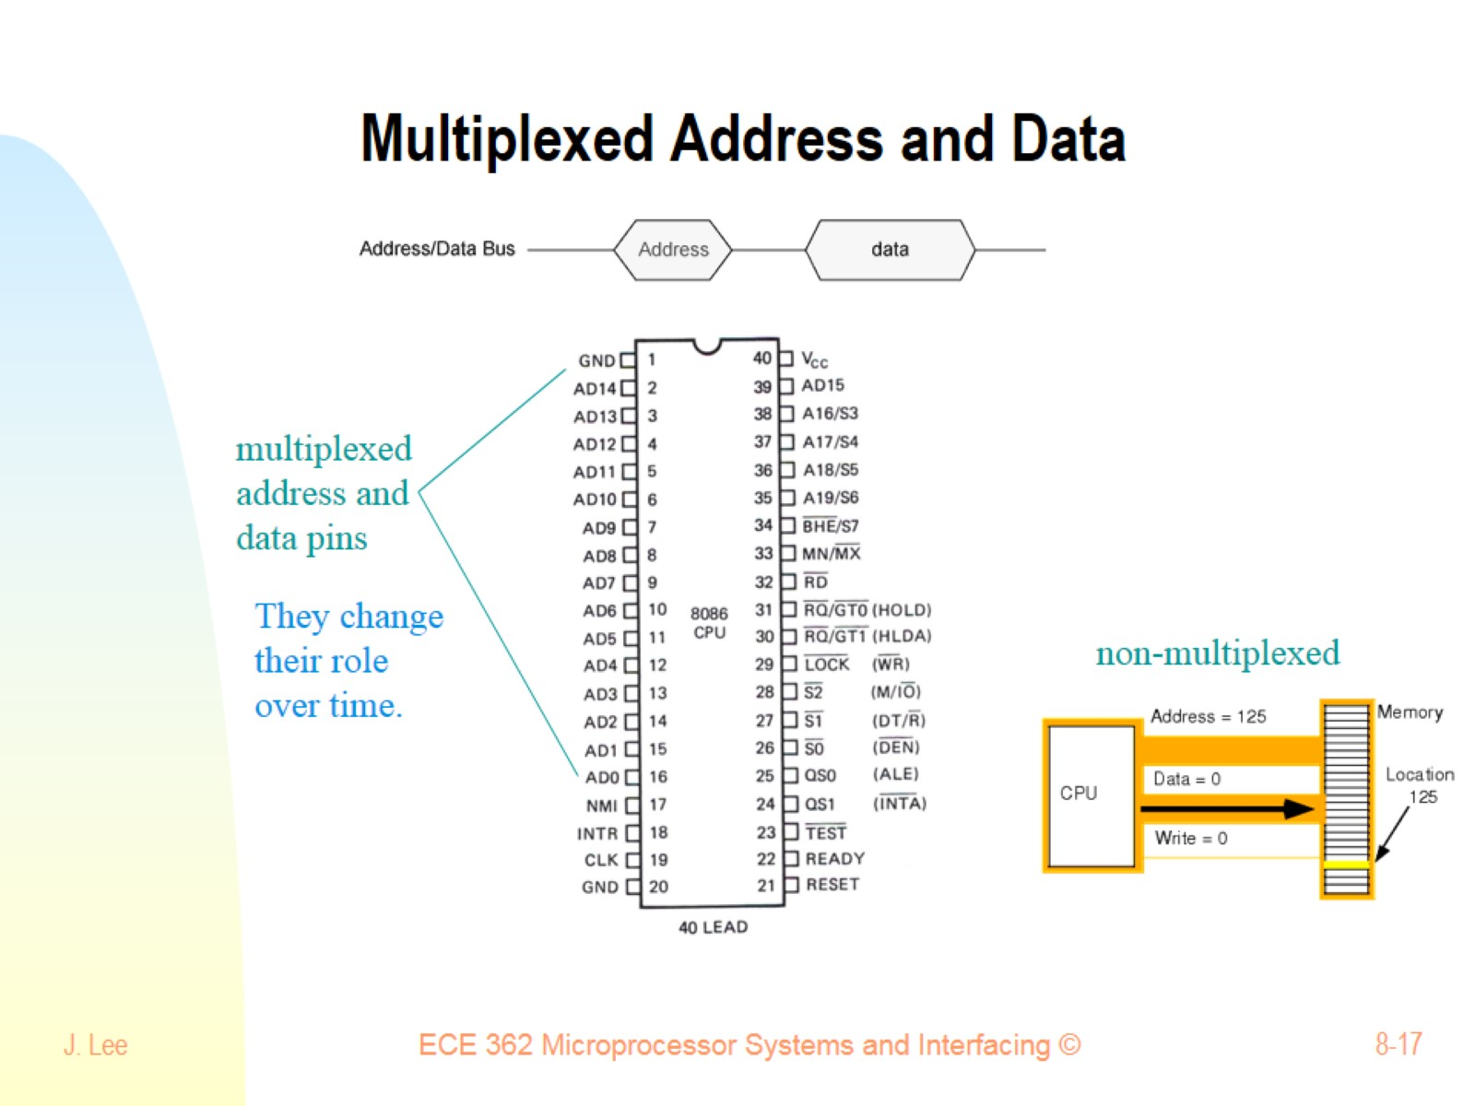
Multiplexed Address and Data

Slide 18
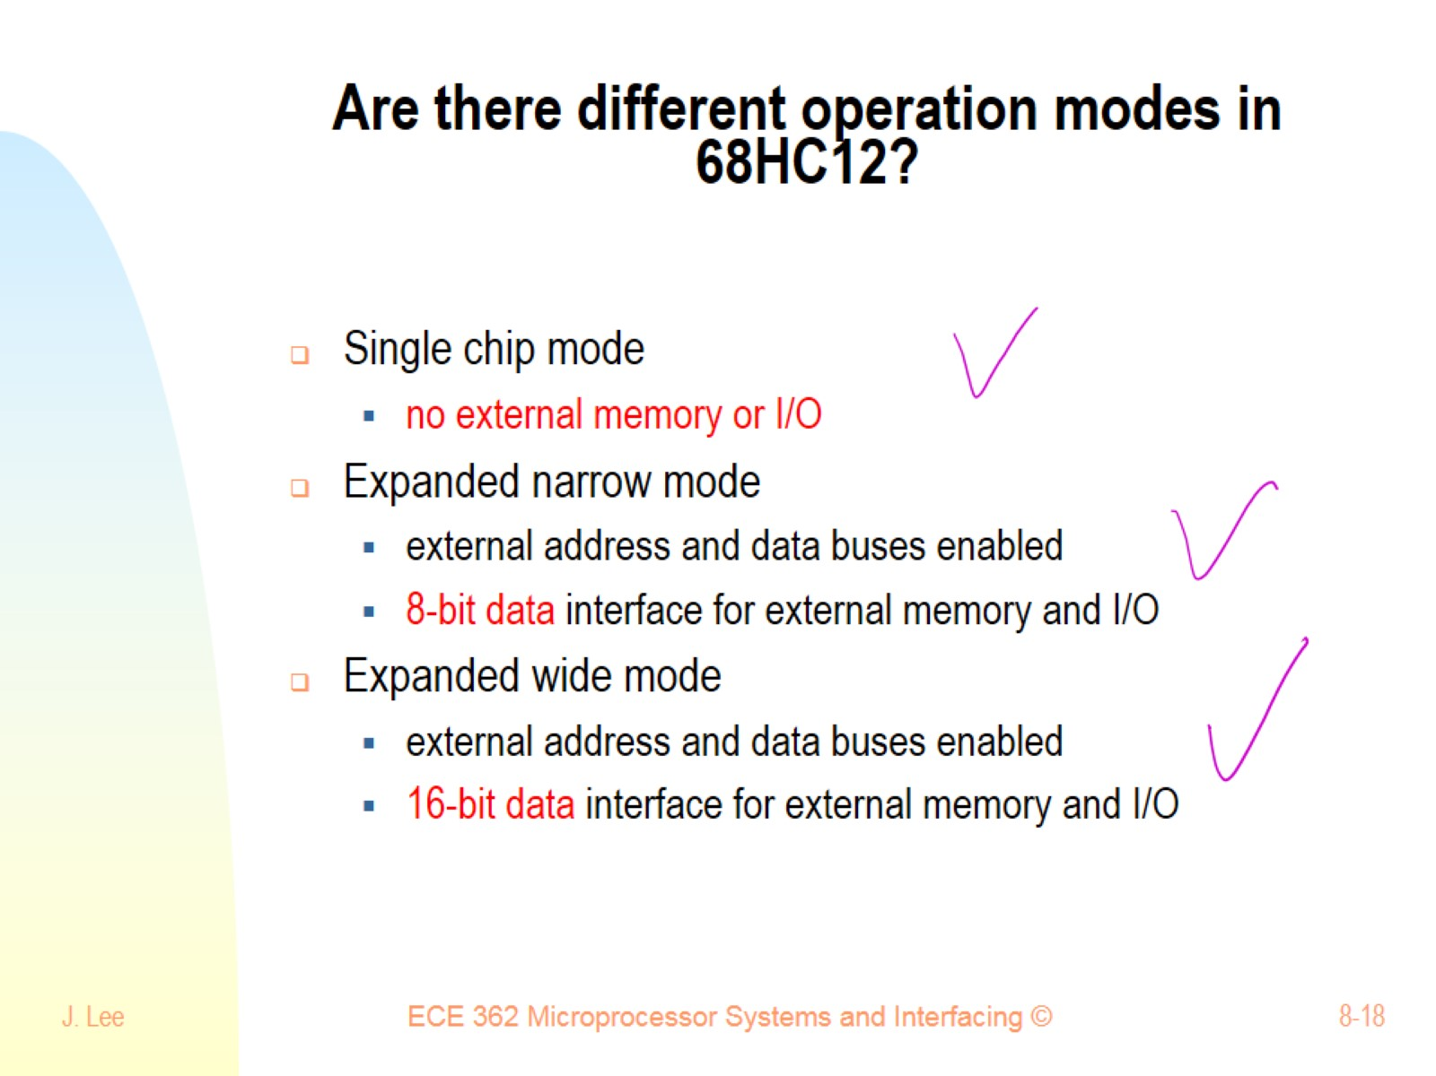
Are there different operation modes in 68HC12?

Slide 19
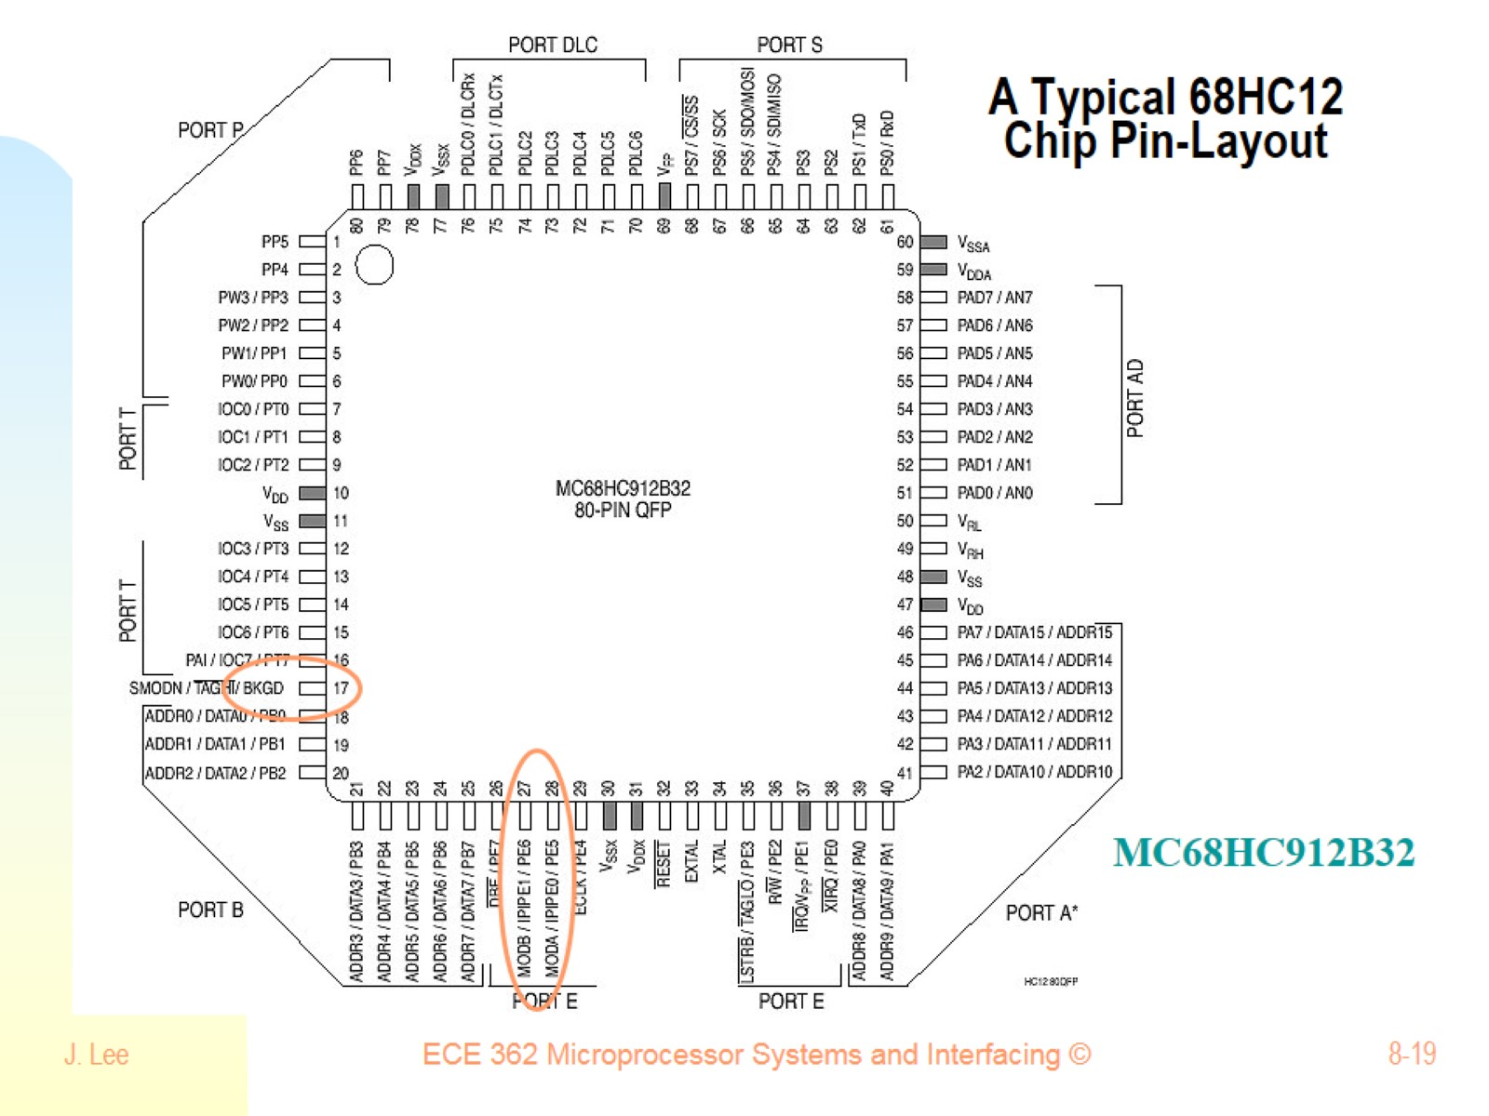
A Typical 68HC12 Chip Pin-Layout

Slide 20
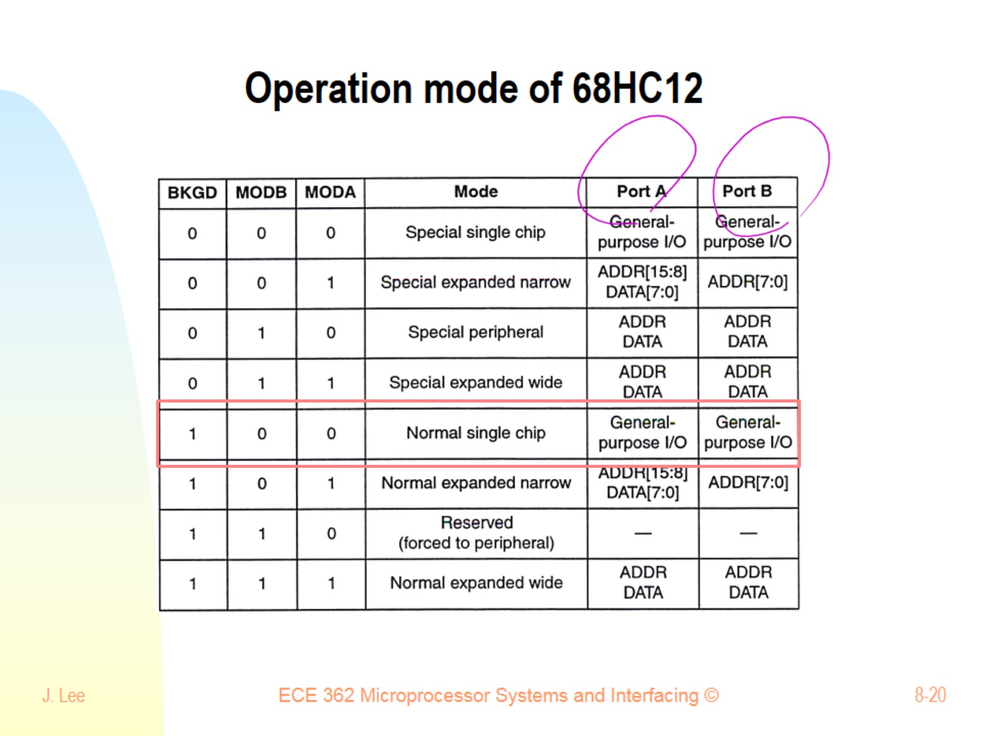
Operation mode of 68HC12

Slide 21
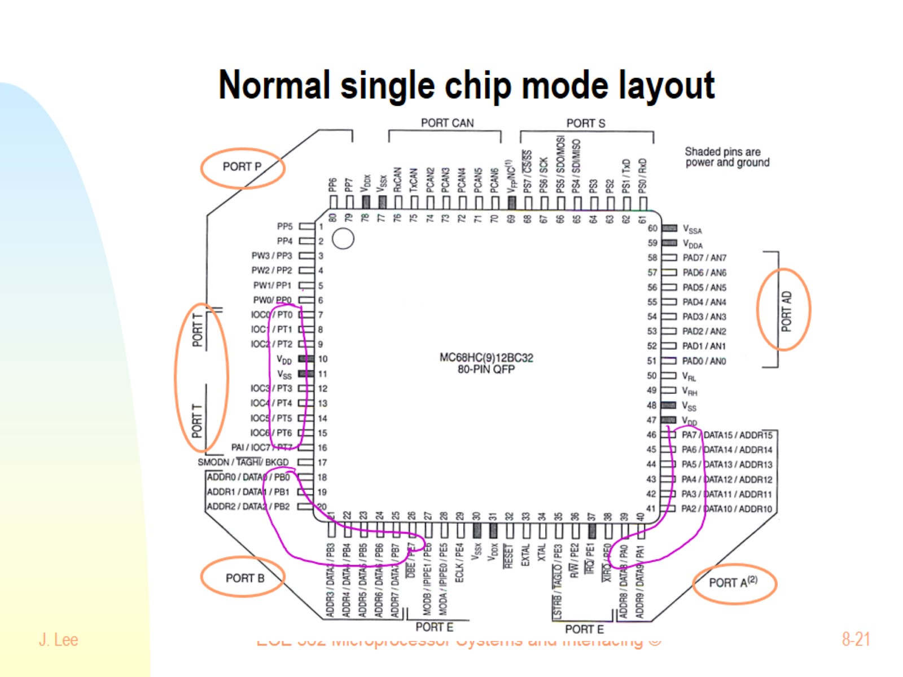
Normal single chip mode layout

Slide 22
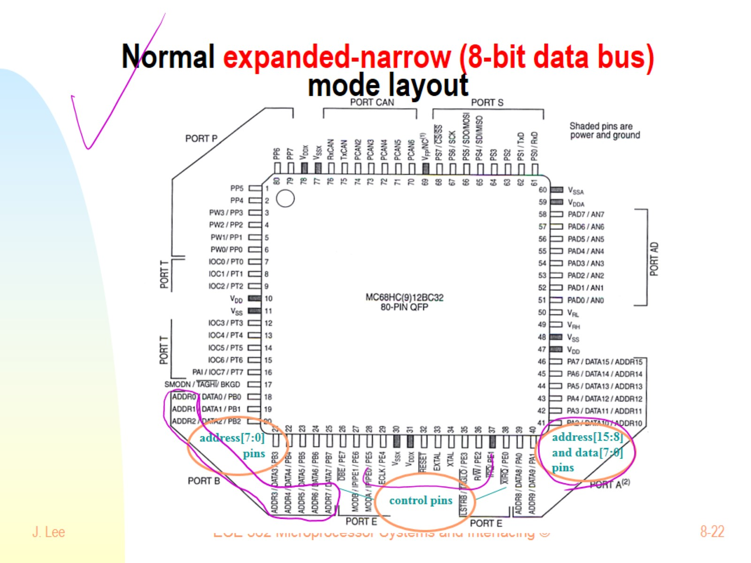
Normal expanded-narrow (8-bit data bus) mode layout

Slide 23

Normal expanded-wide (16-bit data bus) mode layout

Slide 24
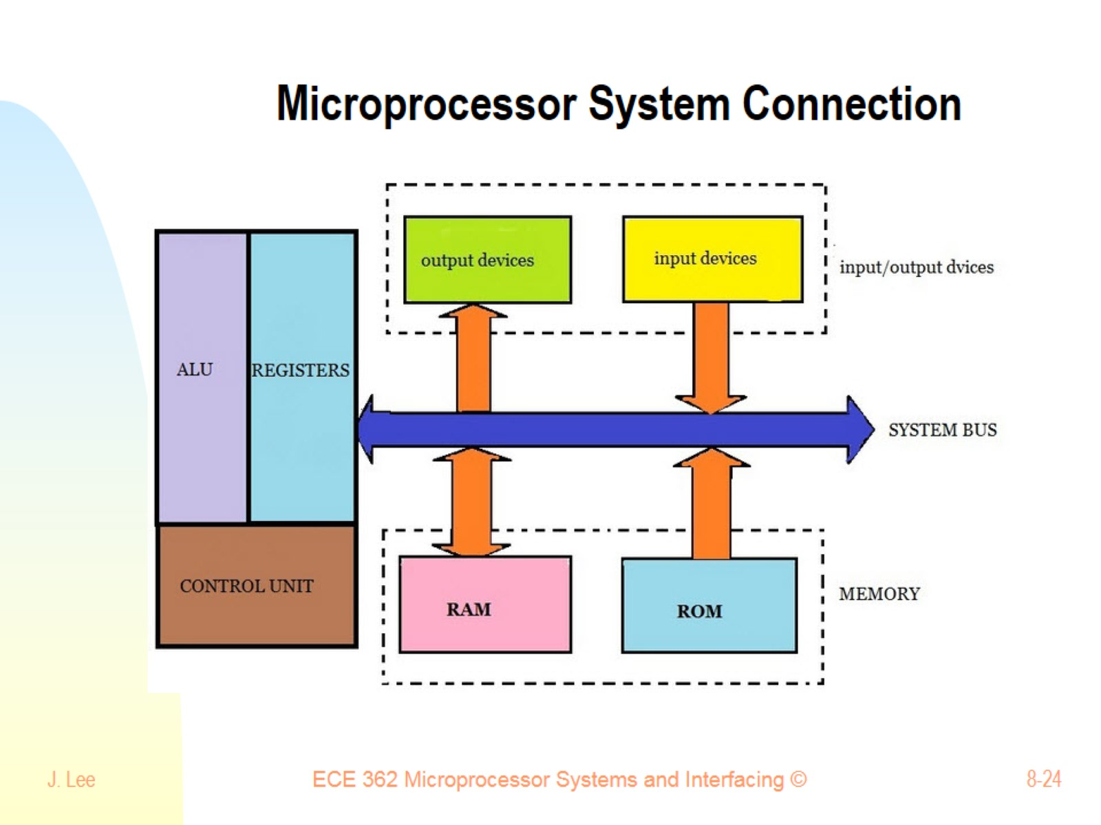
Microprocessor System Connection

Slide 25
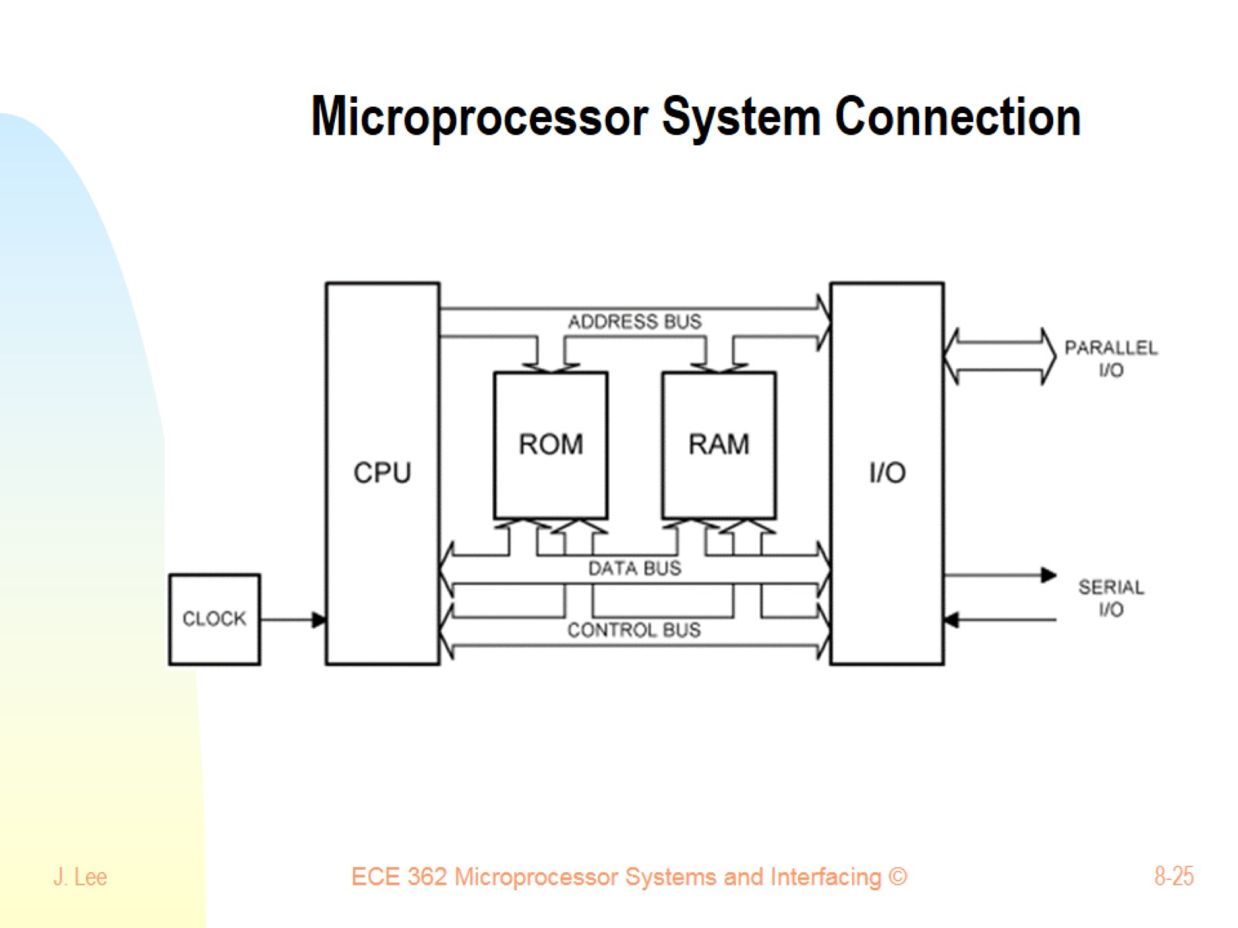
Microprocessor System Connection

Slide 26
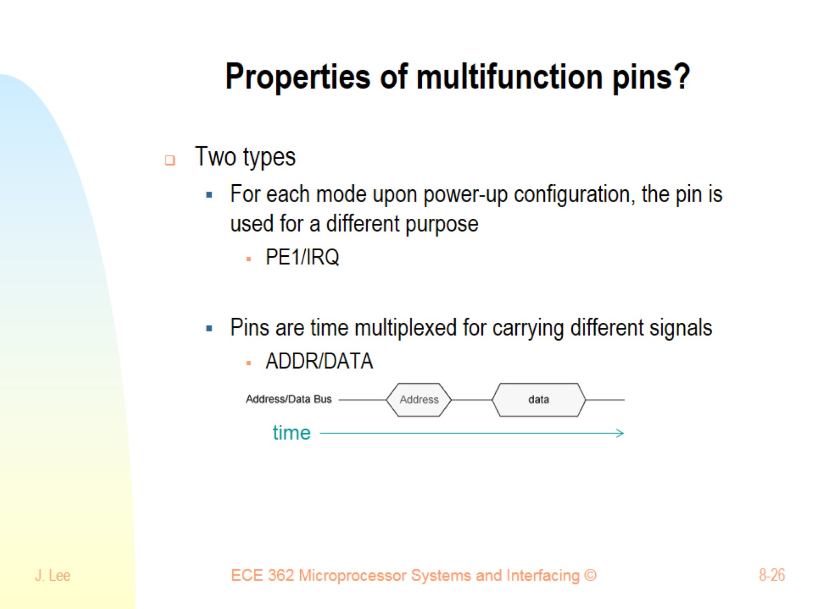
Properties of multifunction pins?

Slide 27
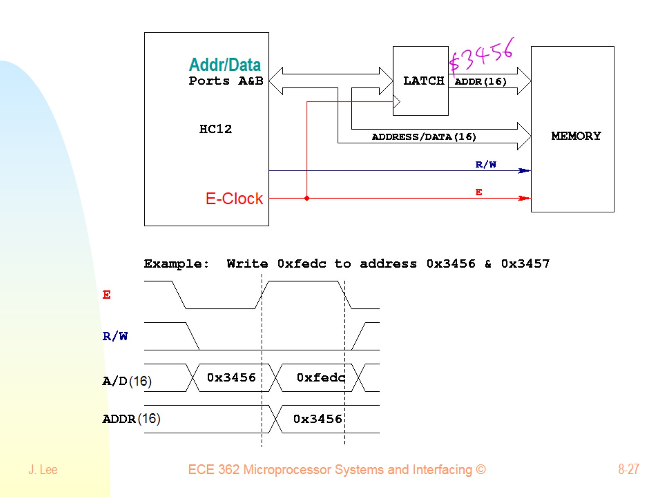

Slide 28
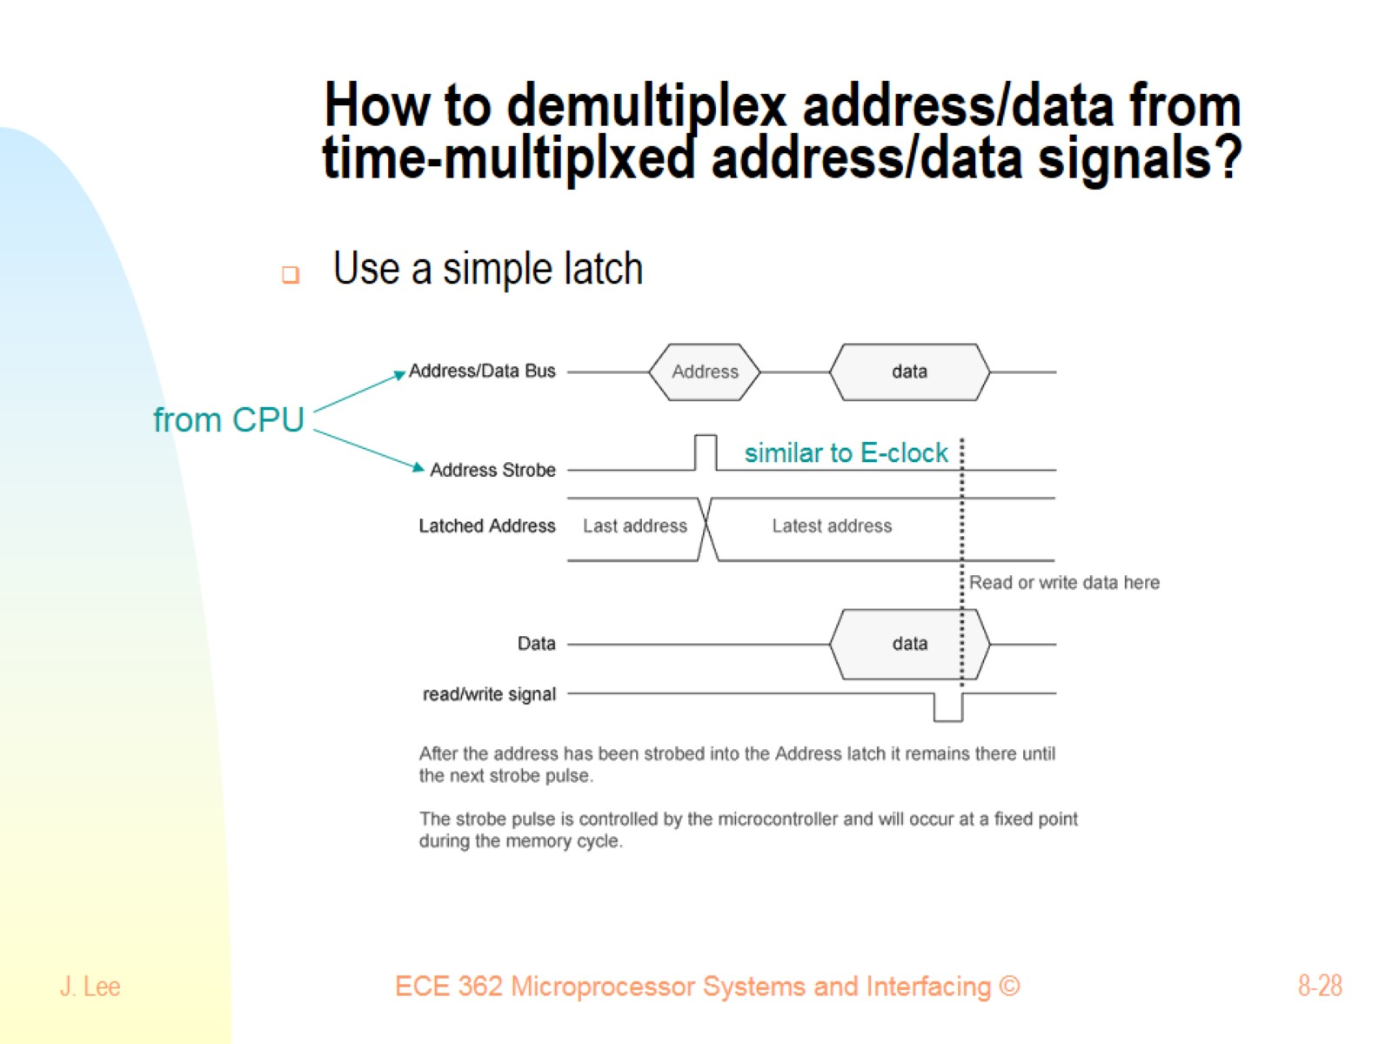
How to demultiplex address/data from time-multiplxed address/data signals?

Slide 29
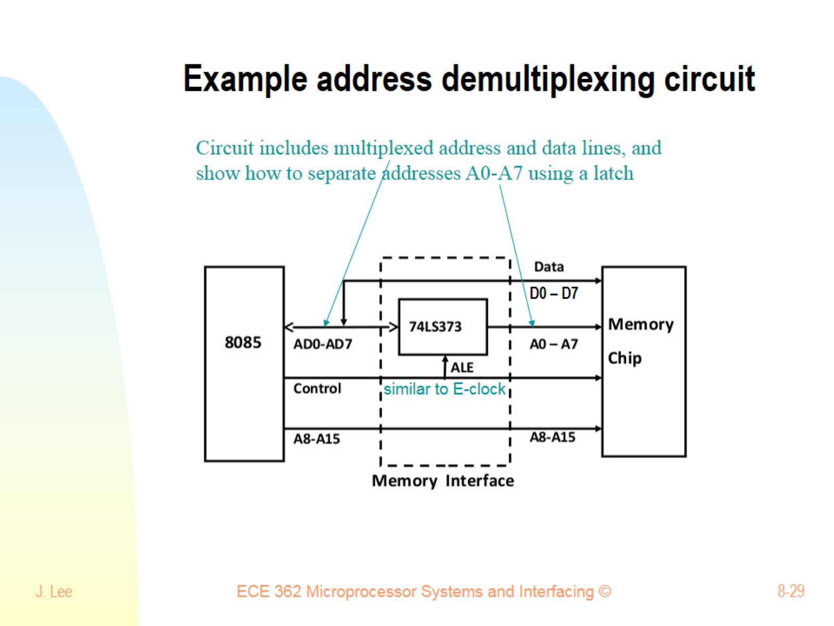
Example address demultiplexing circuit

Slide 30
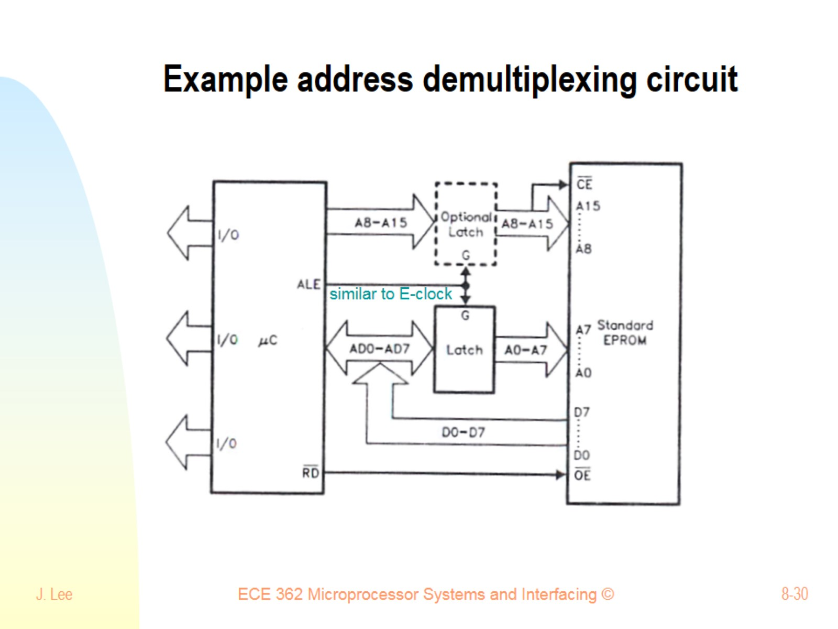
Example address demultiplexing circuit

Slide 31
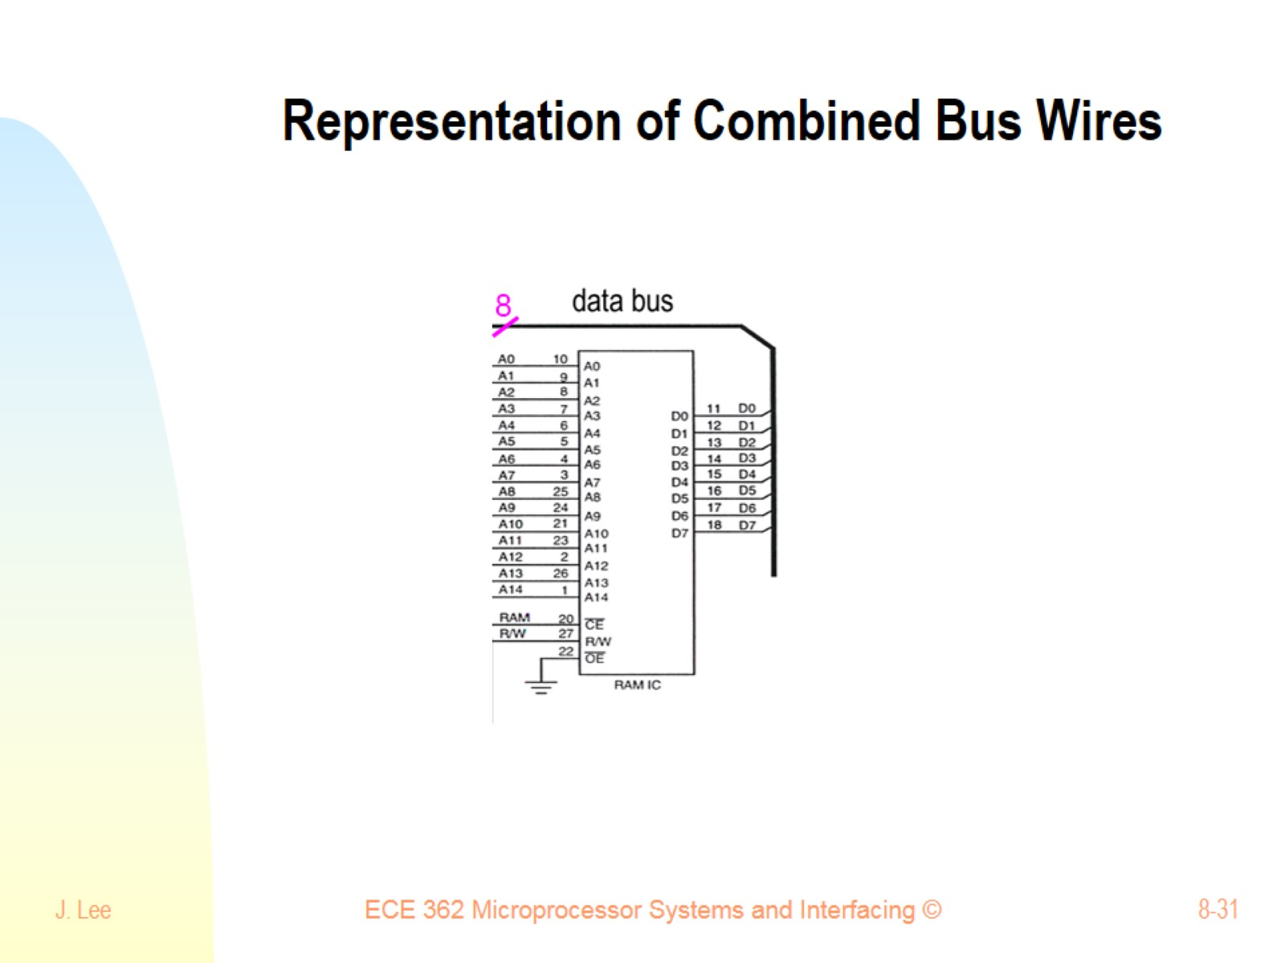
Representation of Combined Bus Wires

Slide 32
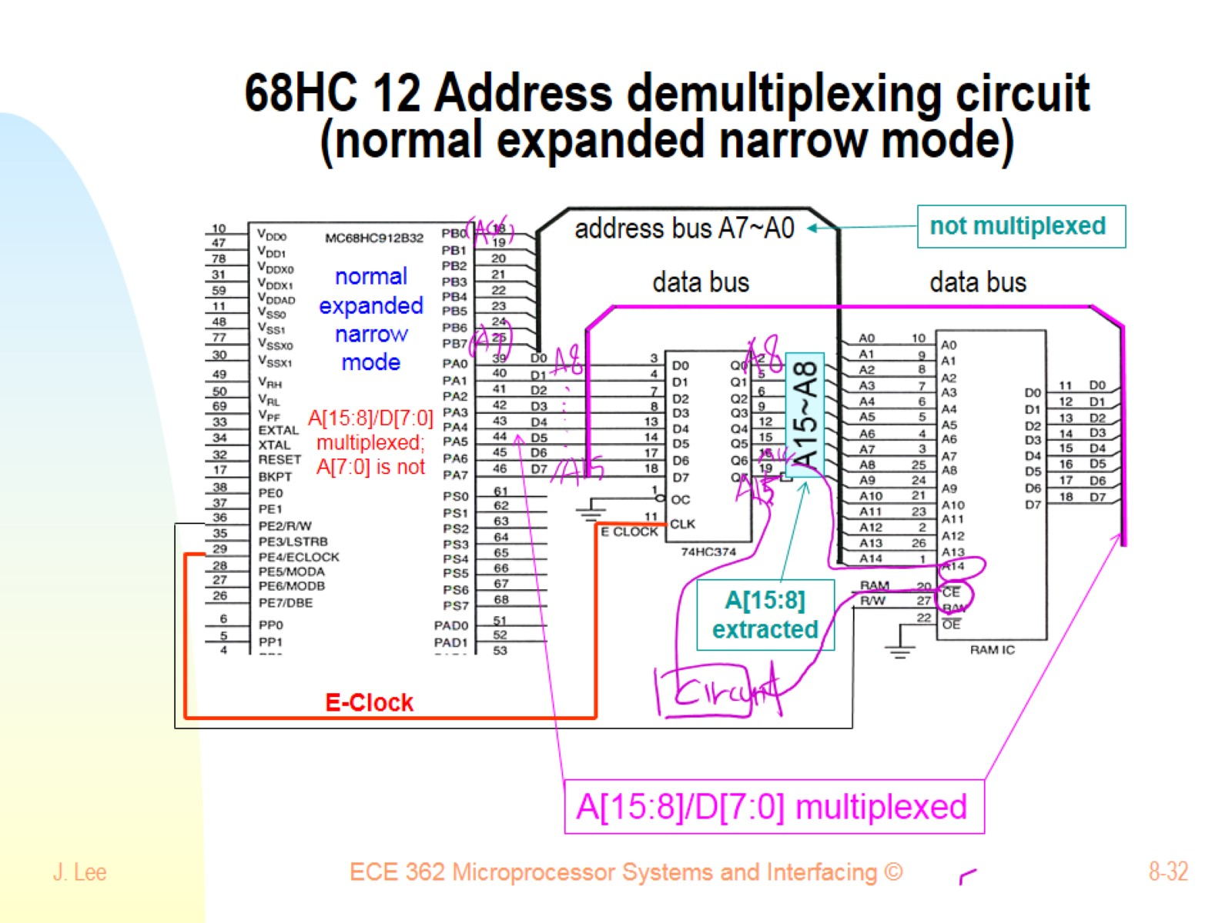
68HC 12 Address demultiplexing circuit (normal expanded narrow mode)

Slide 33
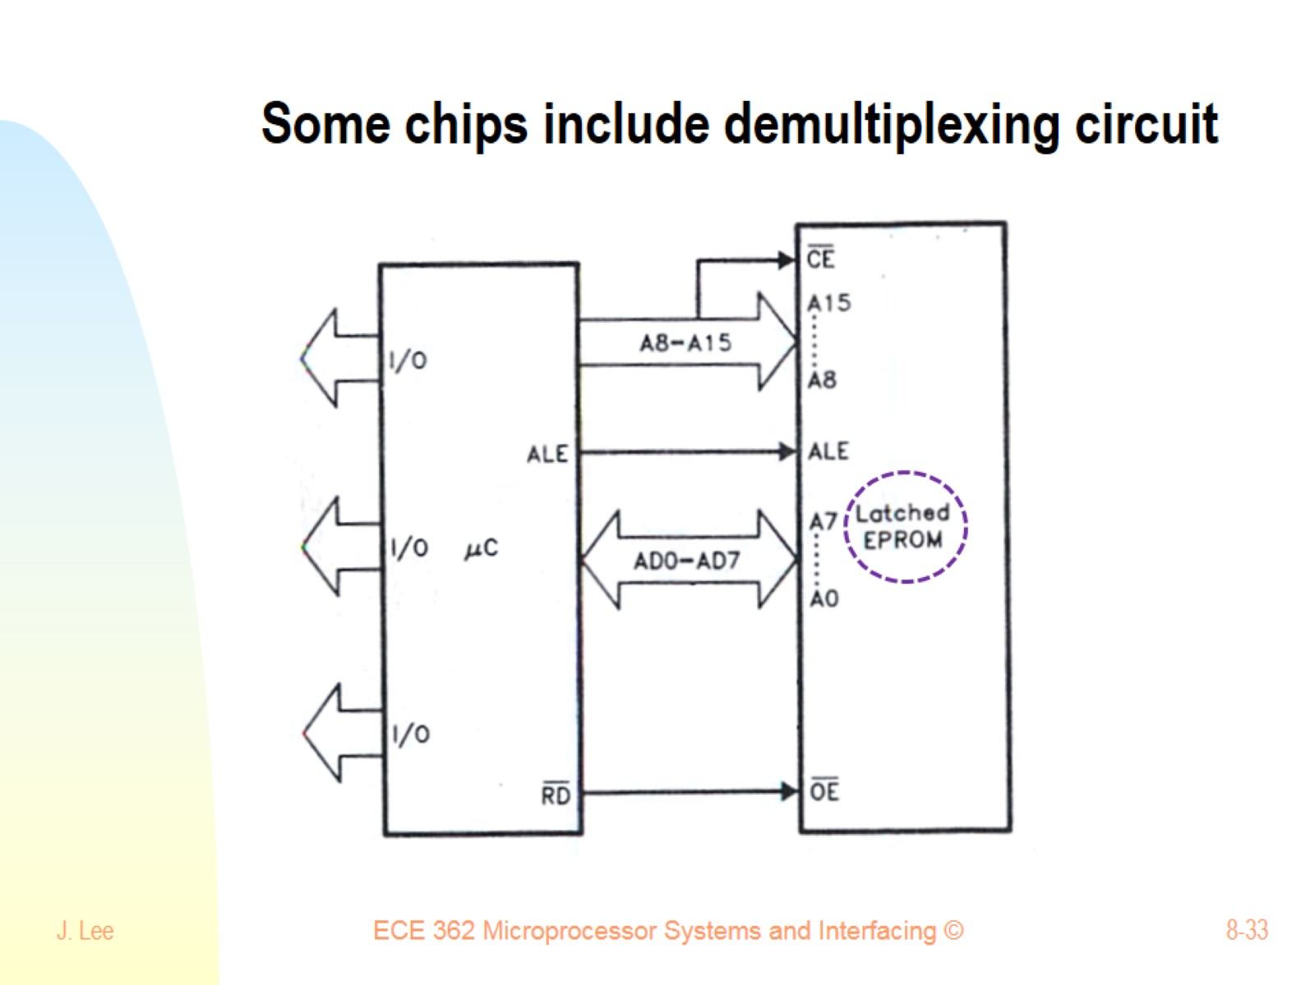
Some chips include demultiplexing circuit

Slide 34
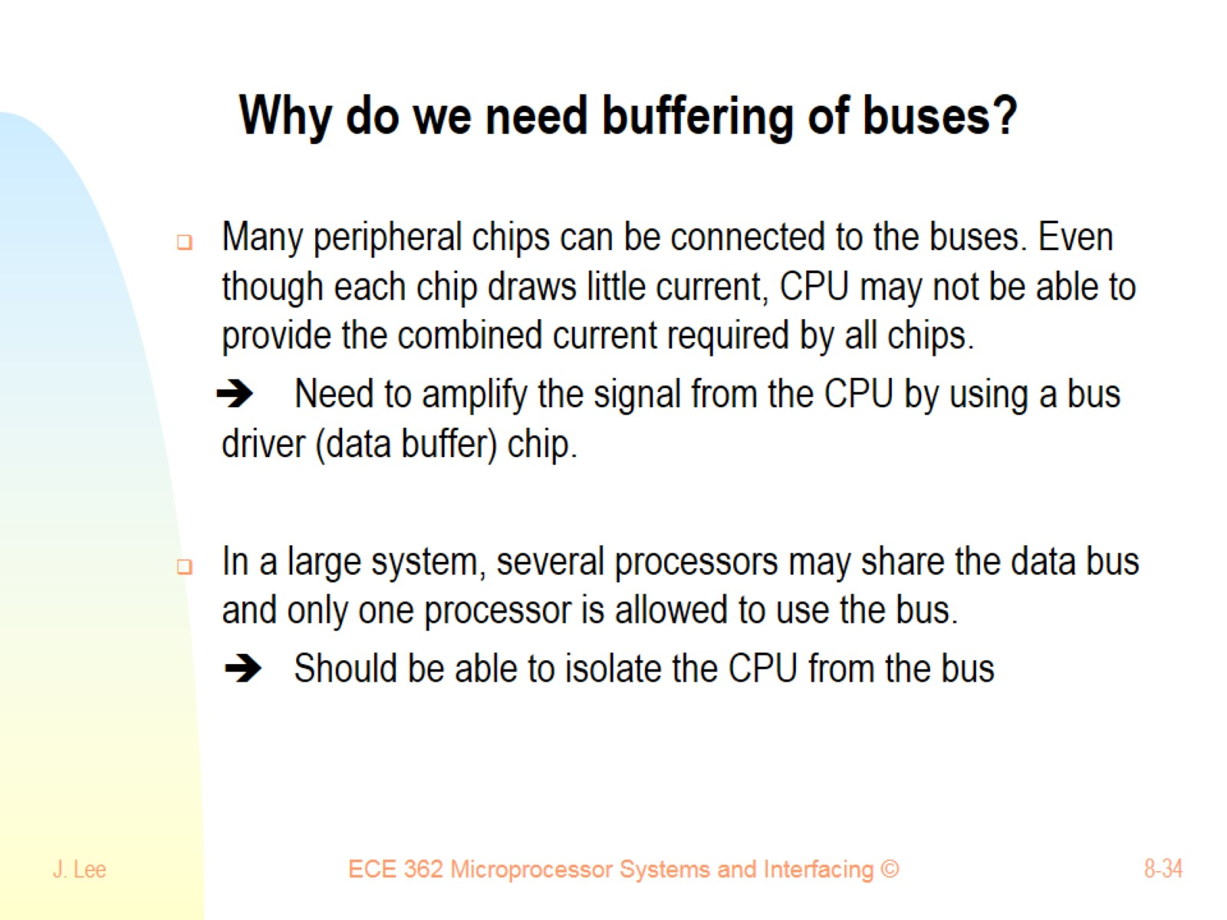
Why do we need buffering of buses?

Slide 35
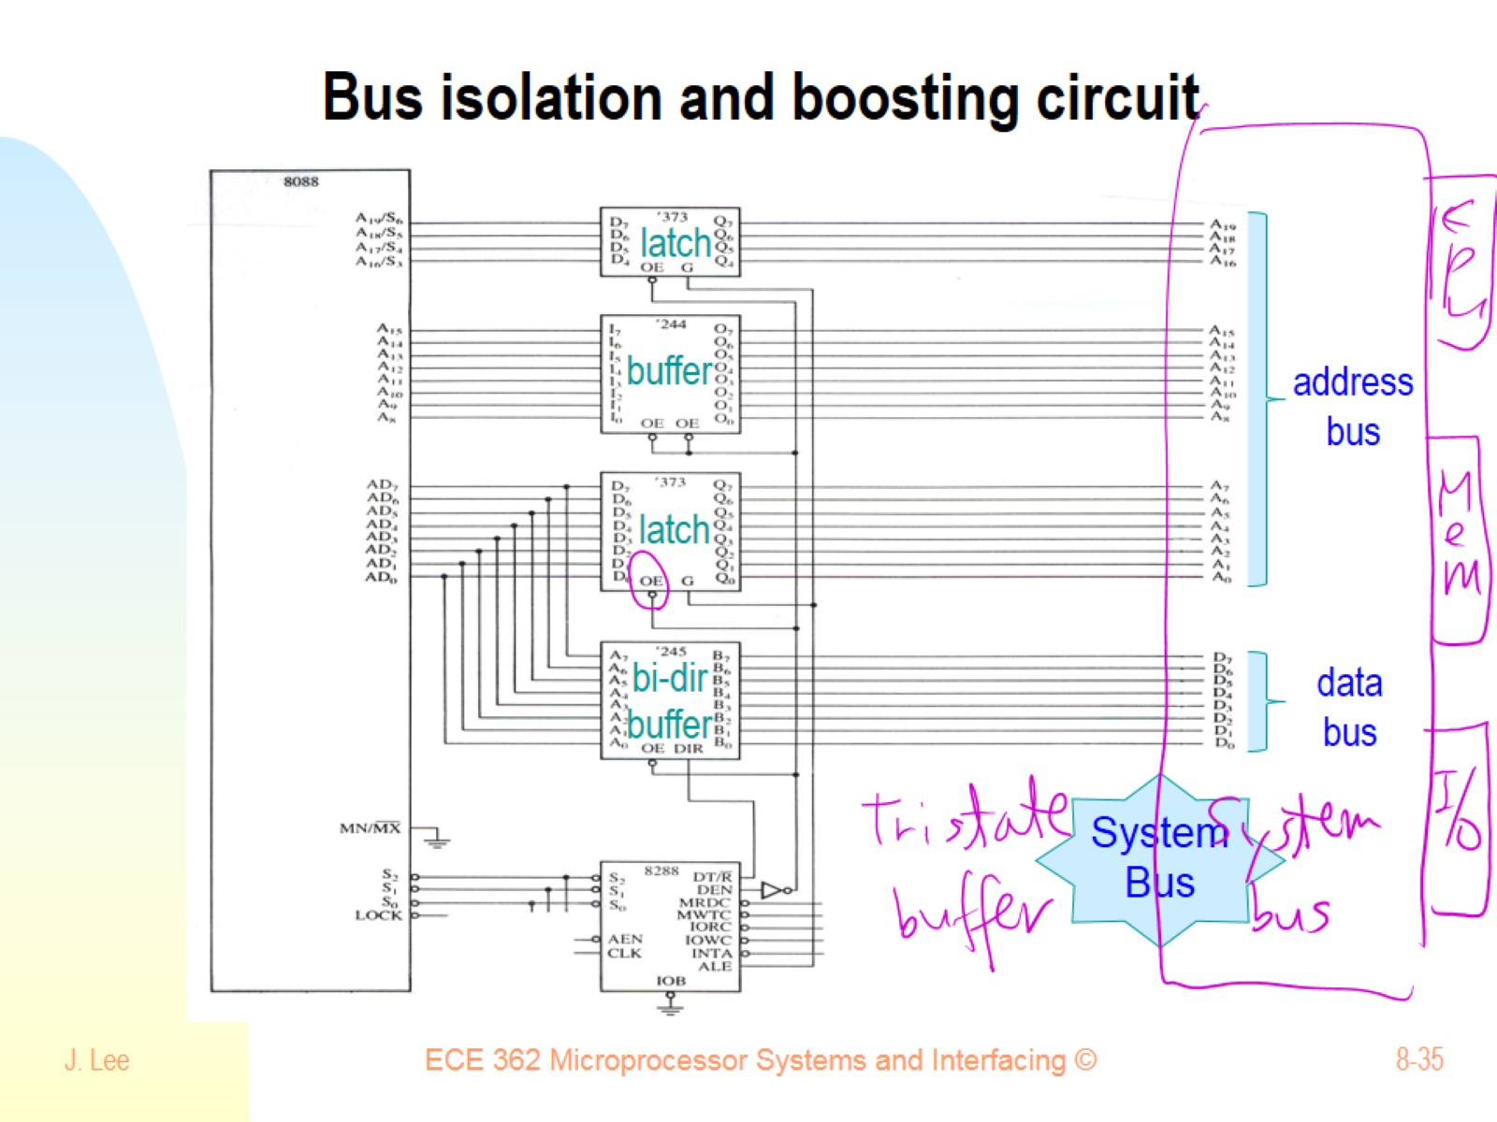
Bus isolation and boosting circuit

Slide 36
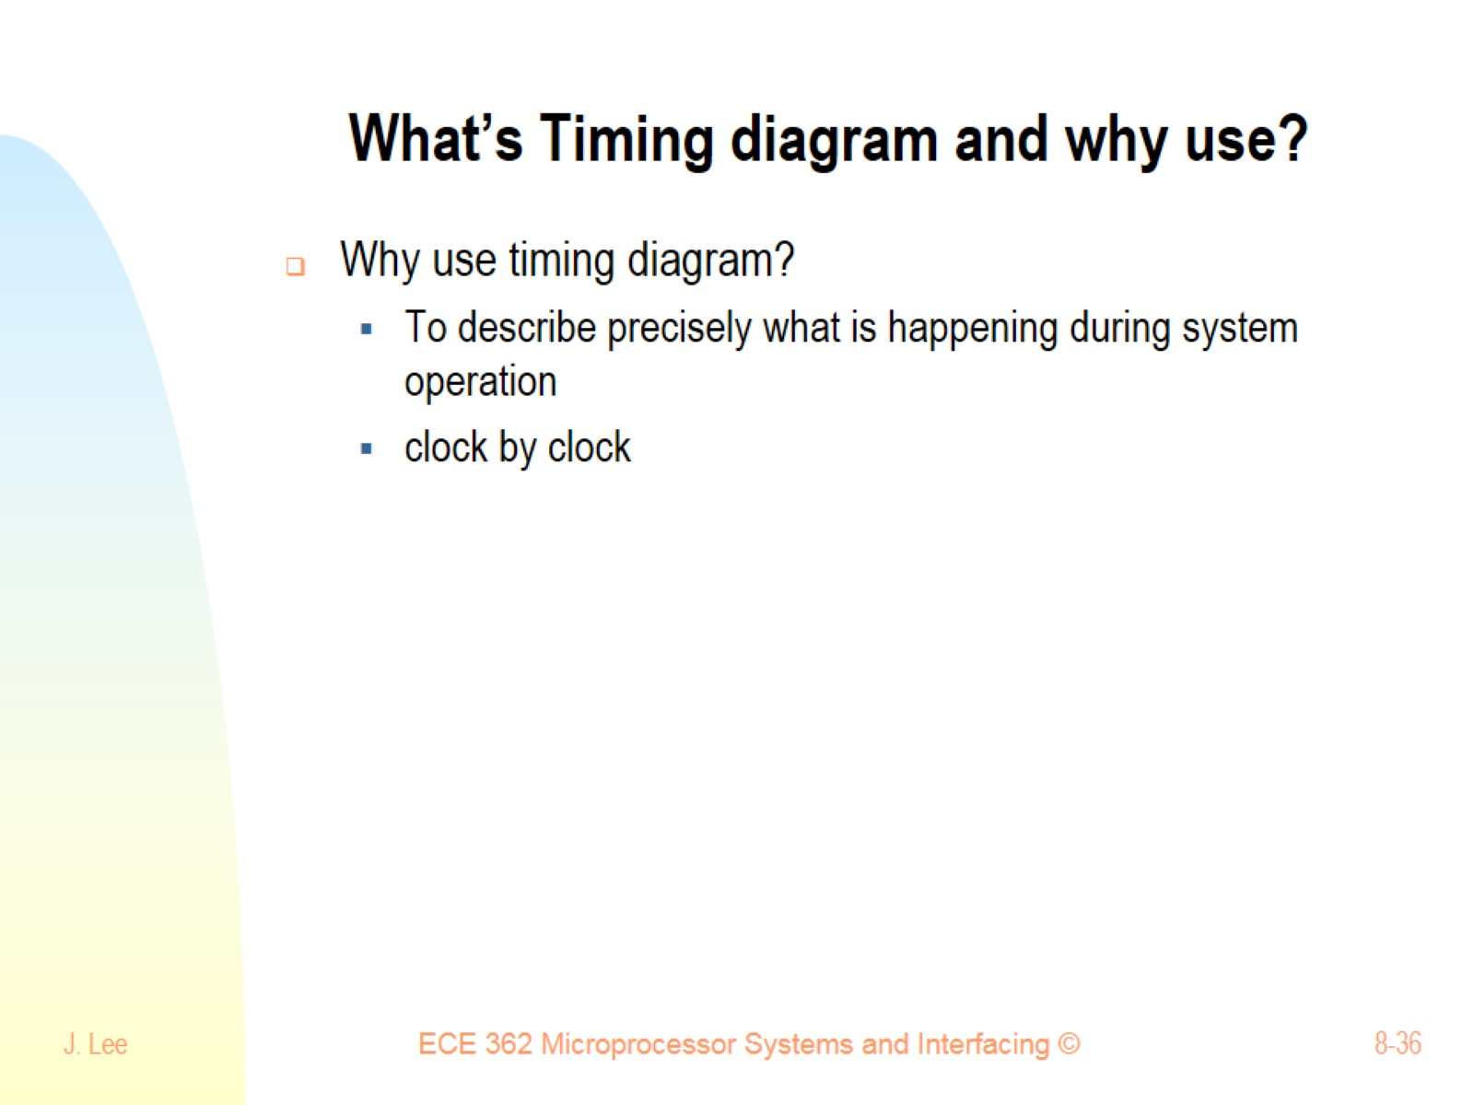
What’s Timing diagram and why use?

Slide 37
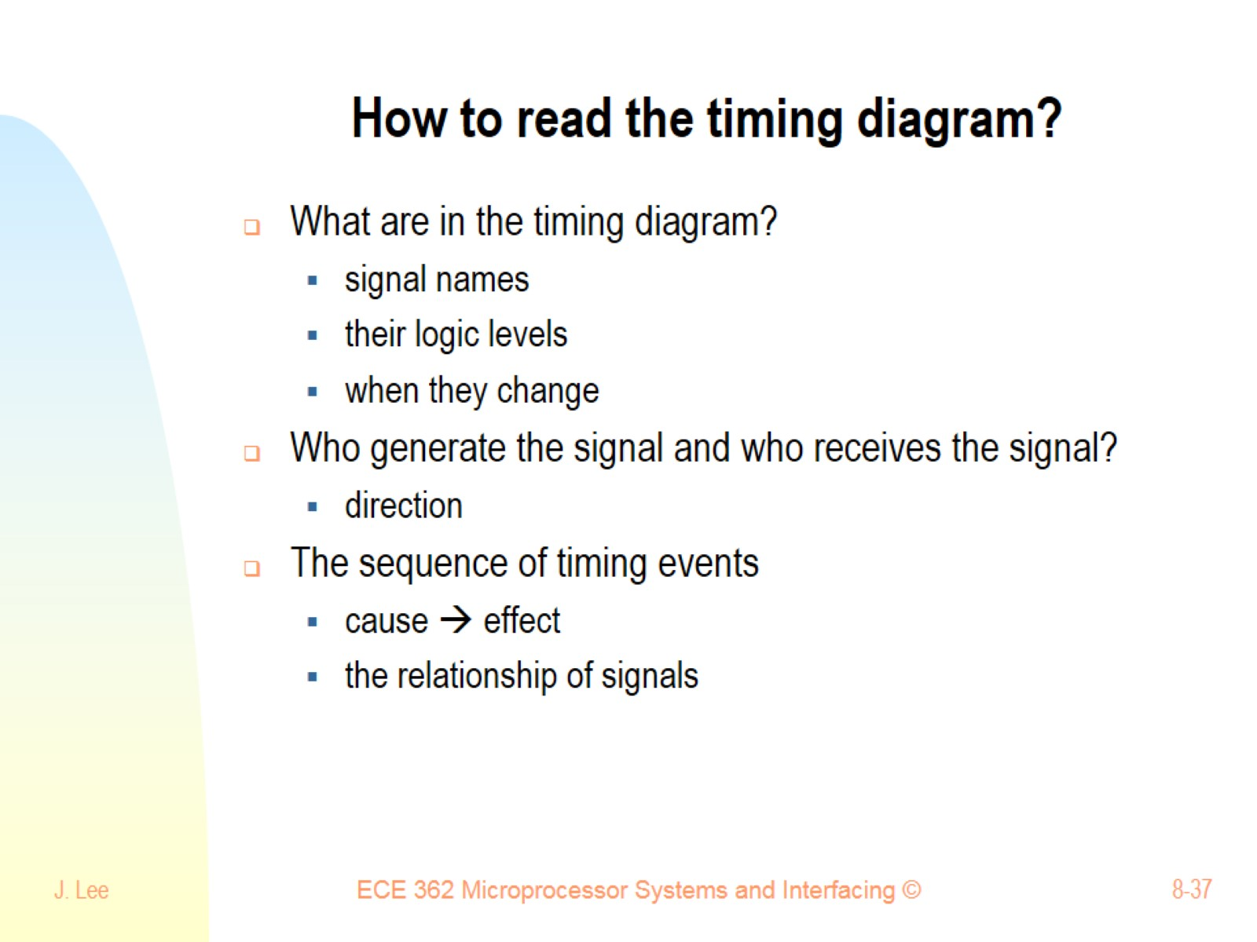
How to read the timing diagram?

Slide 38
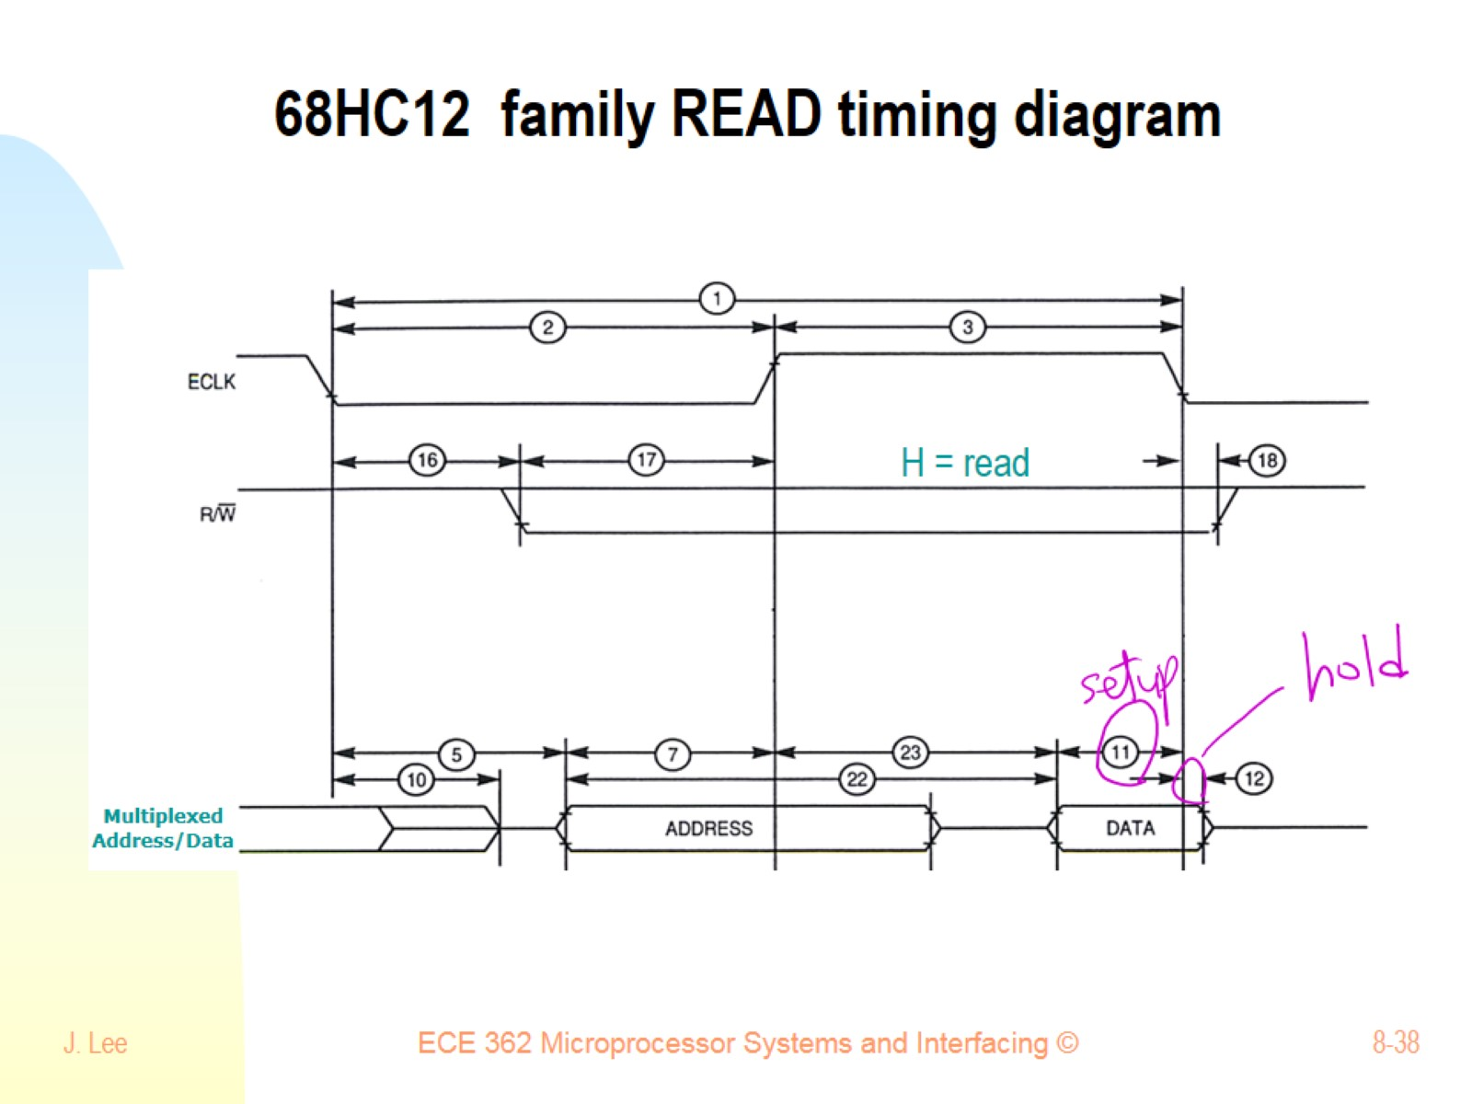
68HC12 family READ timing diagram

Slide 39
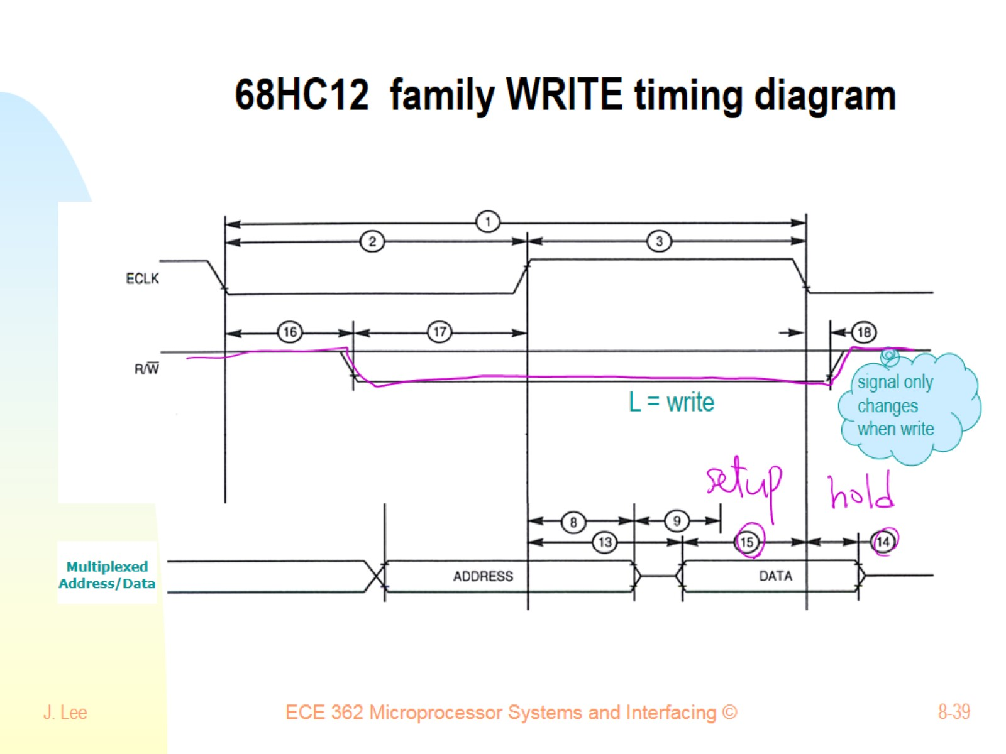
68HC12 family WRITE timing diagram

Slide 40
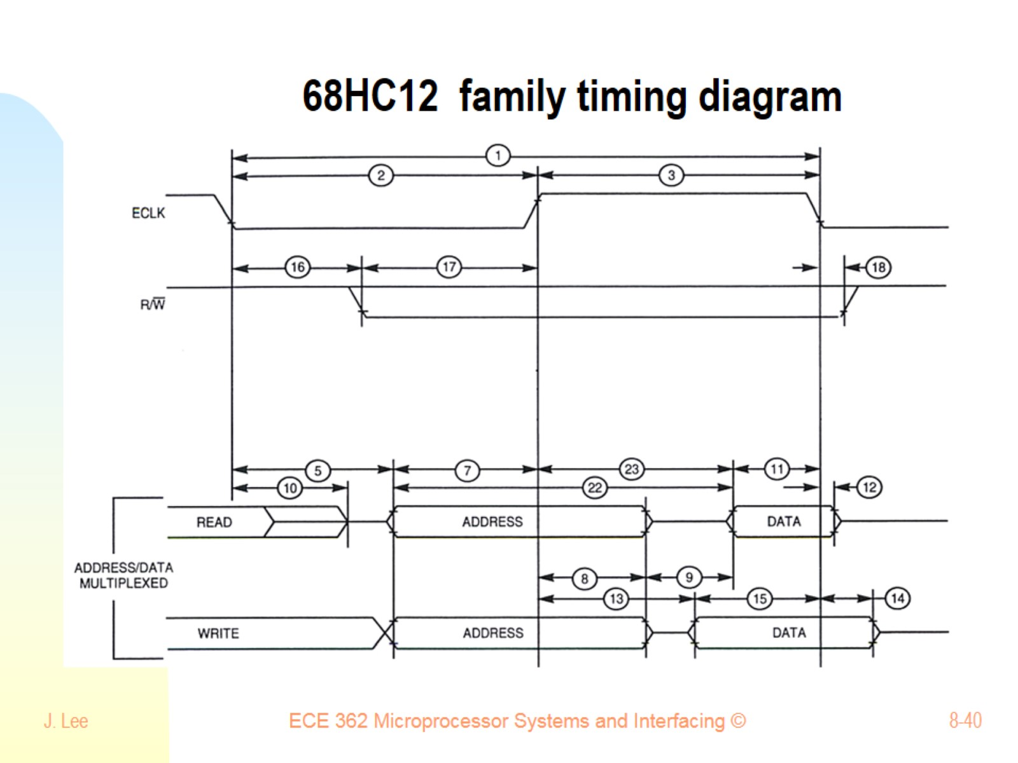
68HC12 family timing diagram

Slide 41
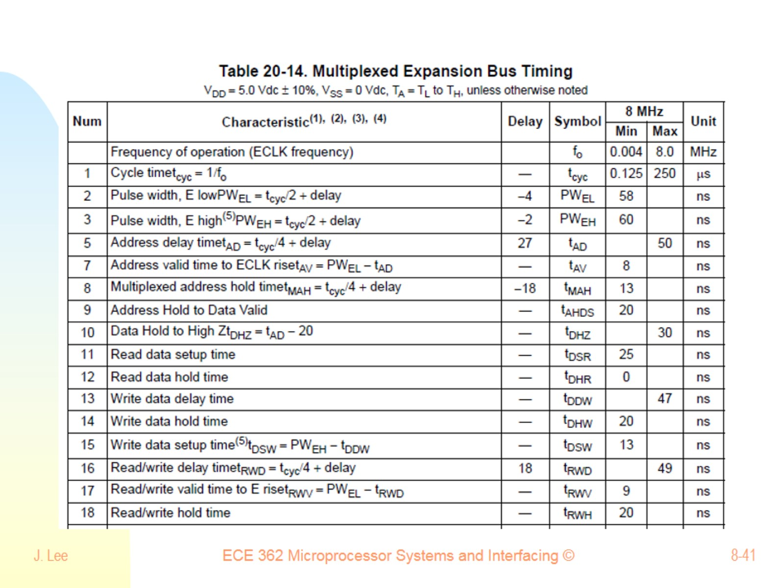

Slide 42
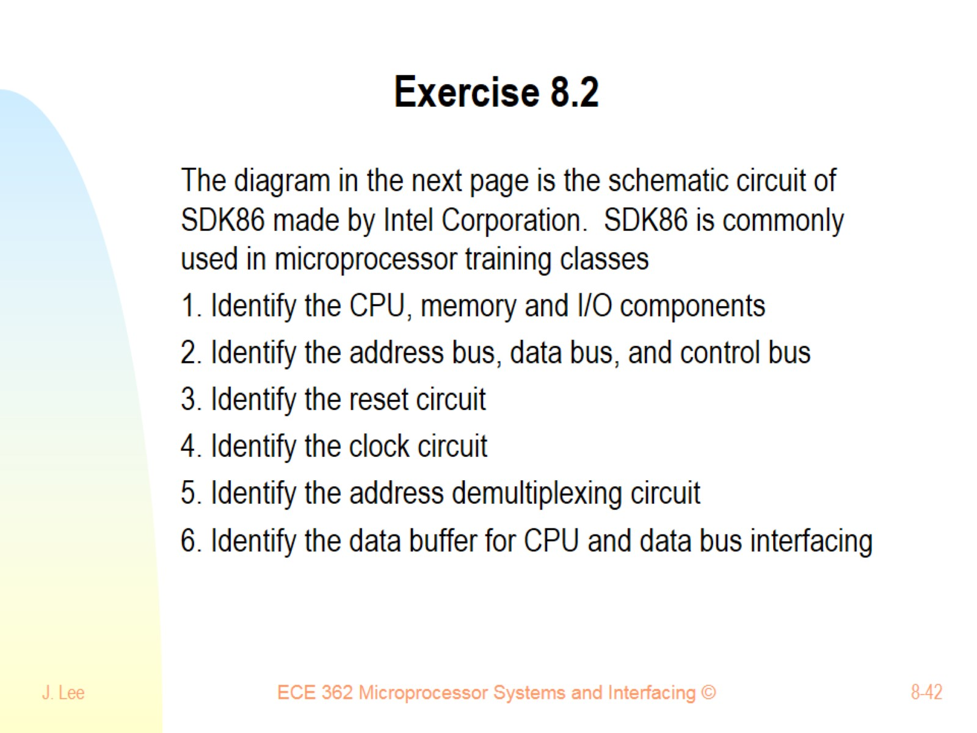
Exercise 8.2

Slide 43
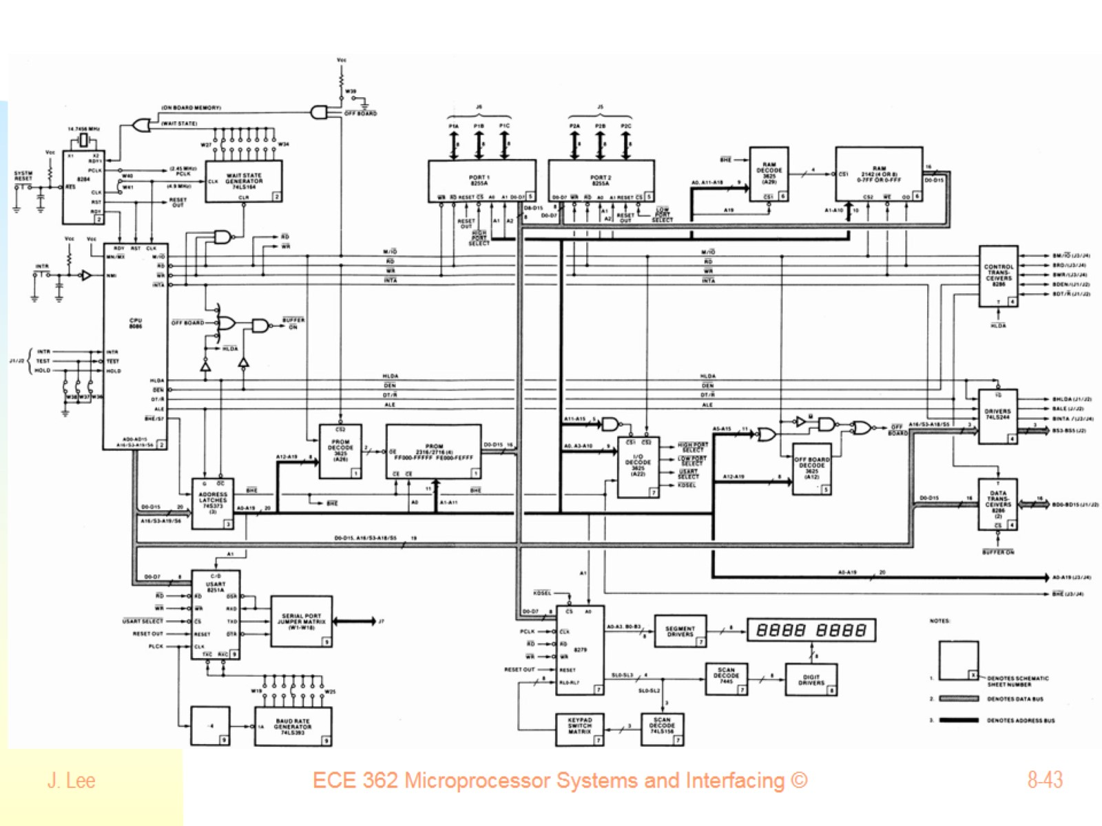

Slide 44
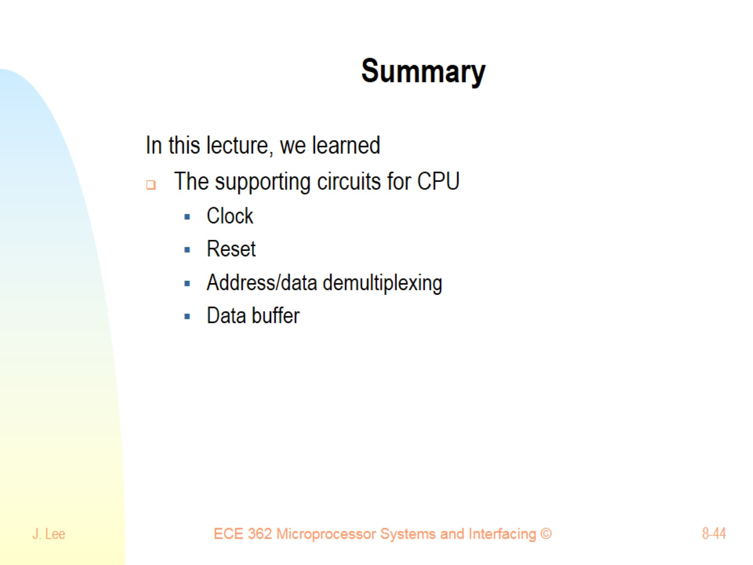
Summary

